Slide 1
Illicit Tobacco Study: York City Council 2021

Slide 2
Study Objectives
Aims of the study were to:
Evaluate the illicit tobacco market for the York City area using the same methodology which has been adopted across all the regions of England and Wales (most extensively in the North East and North West)
Measure the proportion of smokers buying illicit tobacco;
Determine the volume of legal and illegal tobacco consumed, and the resulting illicit tobacco market share;
Identify sources and channels of illicit tobacco purchase, as well as type of illicit being bought;
Identify those most, and least, likely to be buyers of illicit tobacco;
Gauge attitudes towards trying and buying illicit tobacco, identifying any barriers or motivations towards illicit tobacco purchase;
Assess comfort levels towards illicit tobacco and perceptions of any potential impact on the wider community
Determine likelihood of reporting the sale of illicit tobacco and preferred channels of reporting; identifying the groups most likely to provide information to the authorities about selling illicit tobacco.

Slide 3
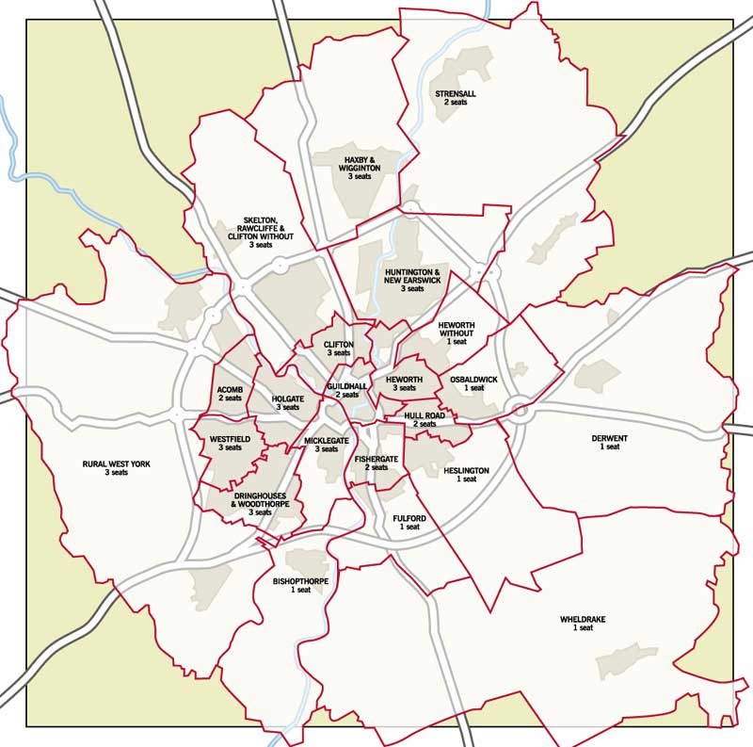
Study Methodology
408 interviews: 232 smokers and 26 illicit tobacco buyers
Interviewing was conducted across all 21 electoral wards
Complementary mix of telephone and face-to-face in-street interviewing
This helps reach a wider audience than any single methodology, thereby boosting survey representation
Sampled adults aged 16+
Quota controls on survey area, gender, age and socio-economic status
Fieldwork was among both smokers and non-smokers
To increase the statistical reliability of smokers, they were oversampled from around a sixth of adults to now represent half the total sample
3-stage data weightings based on gender & age, smoking prevalence (according to Census and Public Health England figures)
Catchment map

Slide 4
Study Terminology
Duty free:
Question wording used was explicit and unambiguous - tobacco that has been purchased on a trip abroad then brought back into this country, through what are deemed by the respondent to be legitimate channels.
Illicit tobacco:
Cheap illicit cigarettes or loose tobacco that can be bought in the UK, and can be either counterfeit (that is, fake) or genuine which have been smuggled into the UK.
This definition was reaffirmed to respondents and augmented to specifically include all product purchased that had either a health warning in a foreign language or no health warning at all.
Purchase prevalence refers to likelihood of purchase
Tobacco volume / market share refers to the proportion of tobacco consumption
“Struggling” refers to financial circumstances and was self-classified by the respondent
Non-smokers are anyone who is not a current smoker
UK purchase, but cheaply priced is illicit tobacco which is a domestically available brand priced below the RRP
Notes:
Struggling: Self-classification of their personal circumstances to be struggling in a financial sense – as opposed to “making ends meet”, “able to save on a regular basis”, “no financial problems”, or “well off”

Slide 5
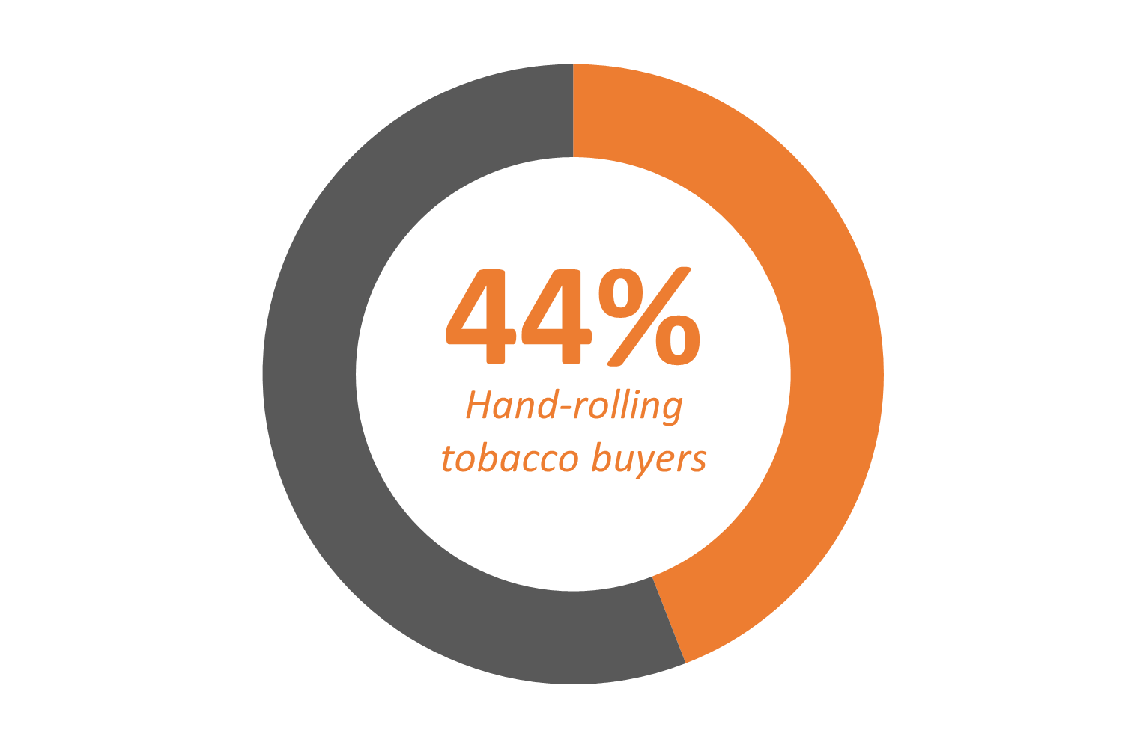
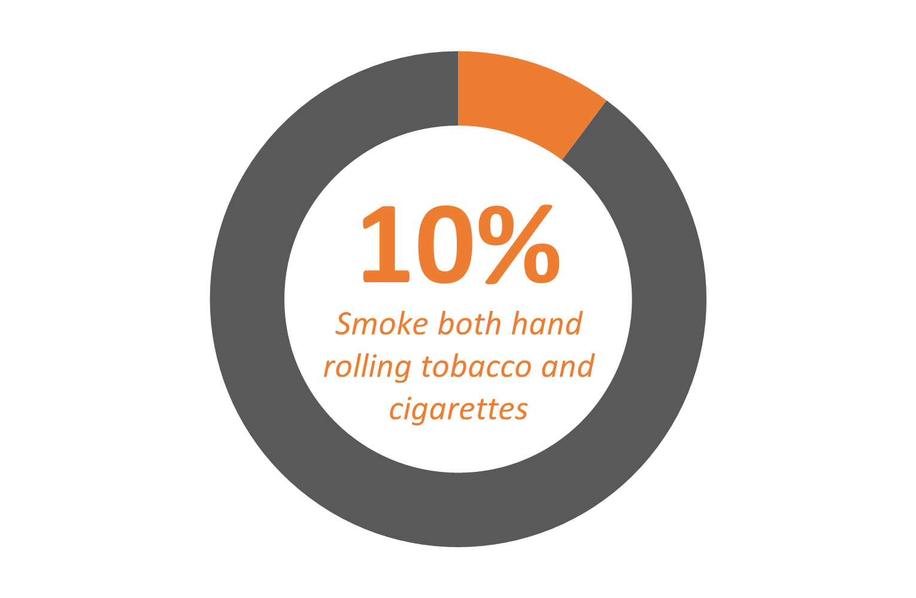
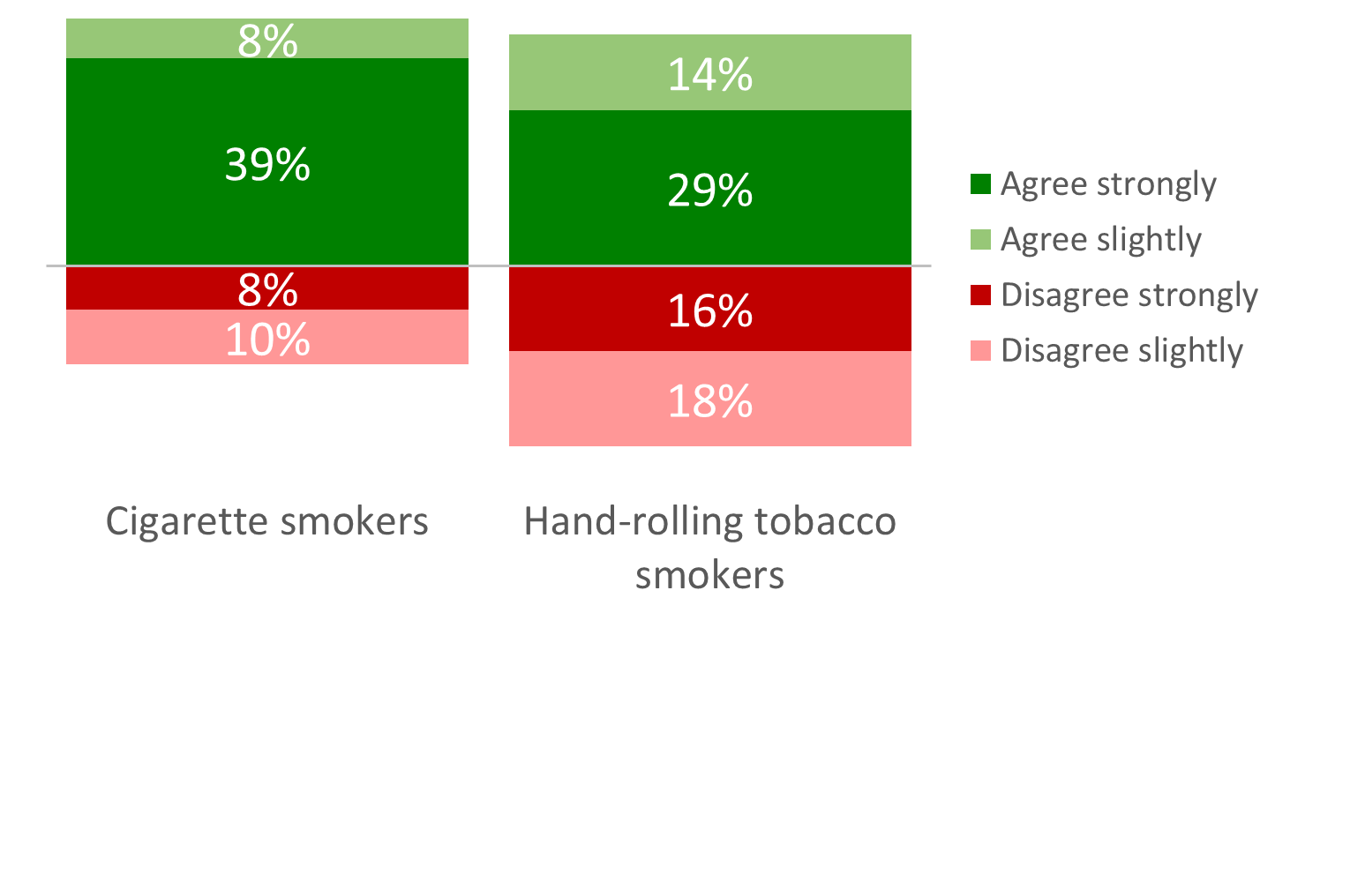
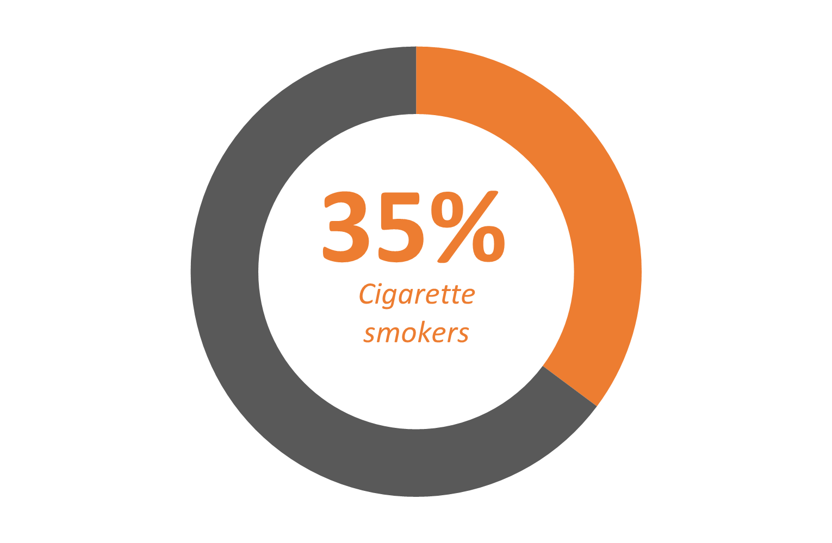
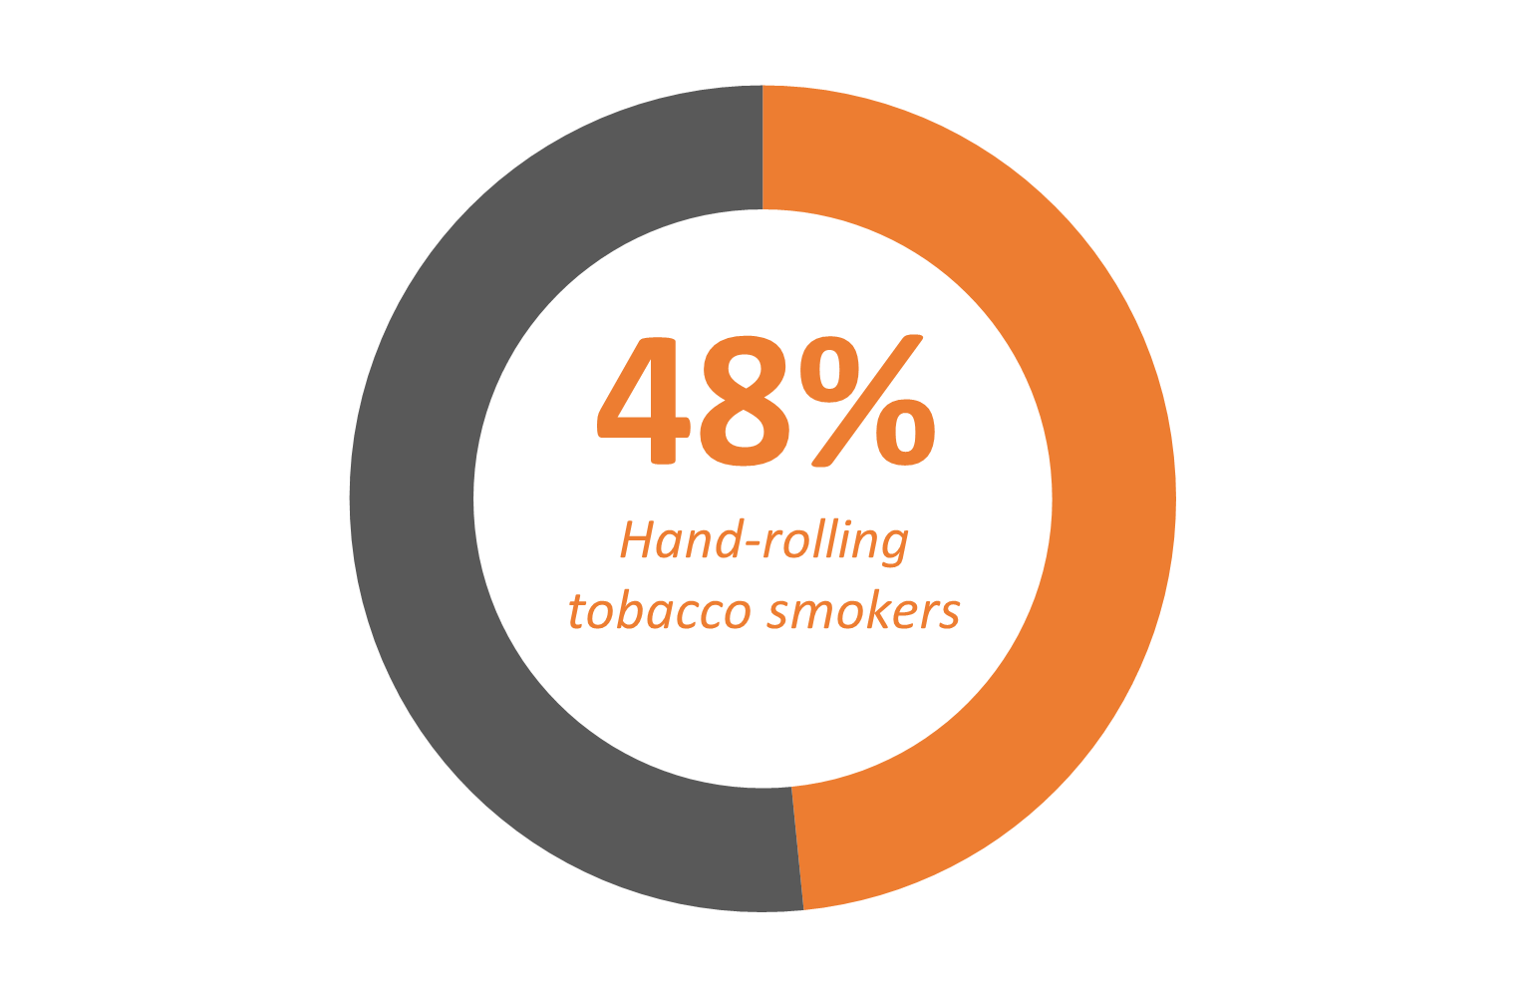
Smoking Habit: Hand-rolling tobacco
Hand-rolling tobacco prevalence (current smokers)
HRT is just as bad for you as manufactured cigarettes
Tobacco consumption (cigarette equivalent)
Tobacco product type: % Socio-economic group DE
Cigarettes smokers:
14 per day
Hand-rolling tobacco smokers:
10 per day
Hand-rolling tobacco prevalence (current smokers)
Notes:
Hand-rolling tobacco consumption converted from grams, ounces, rollies to cigarette equivalent

Slide 6
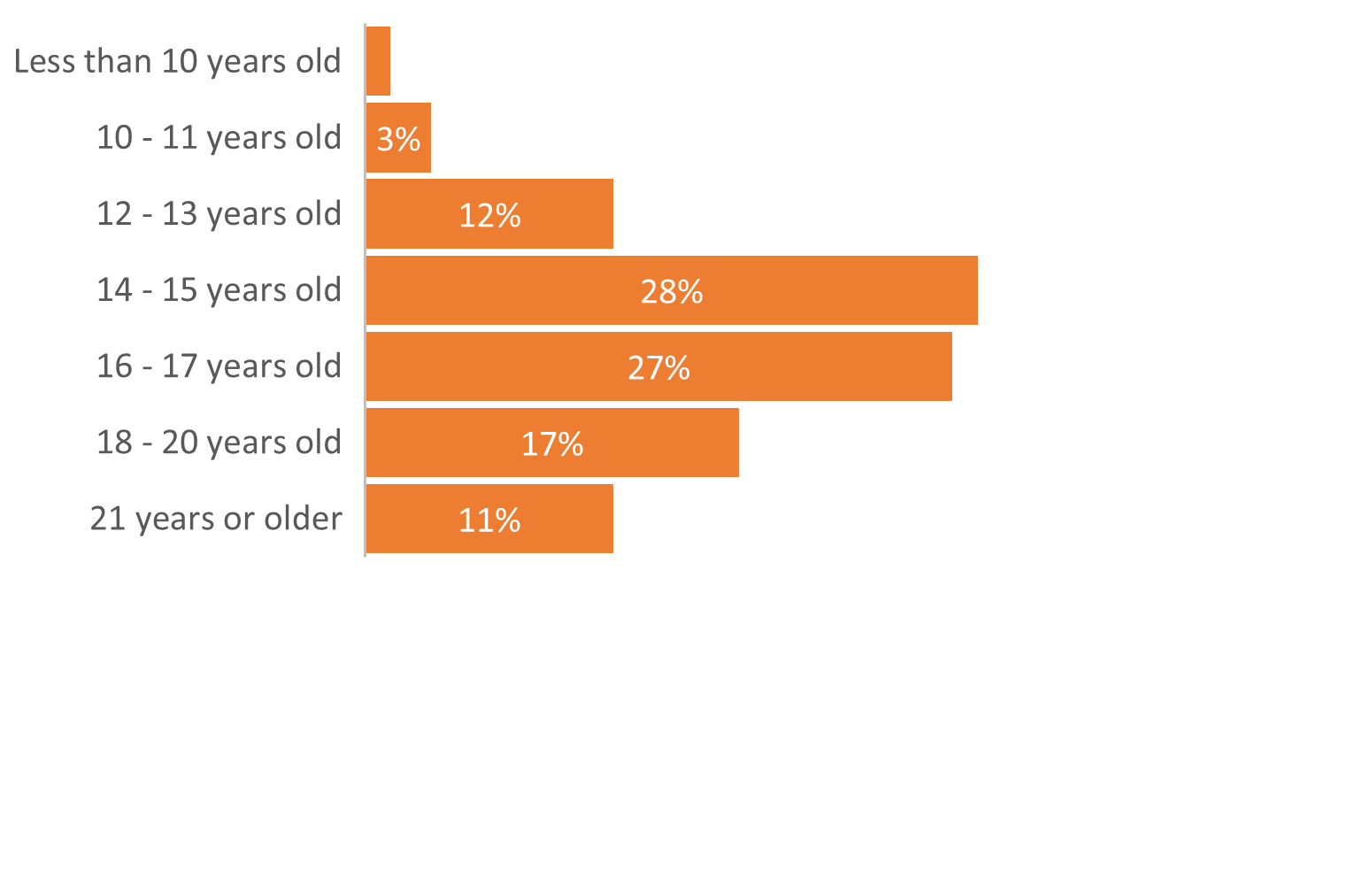
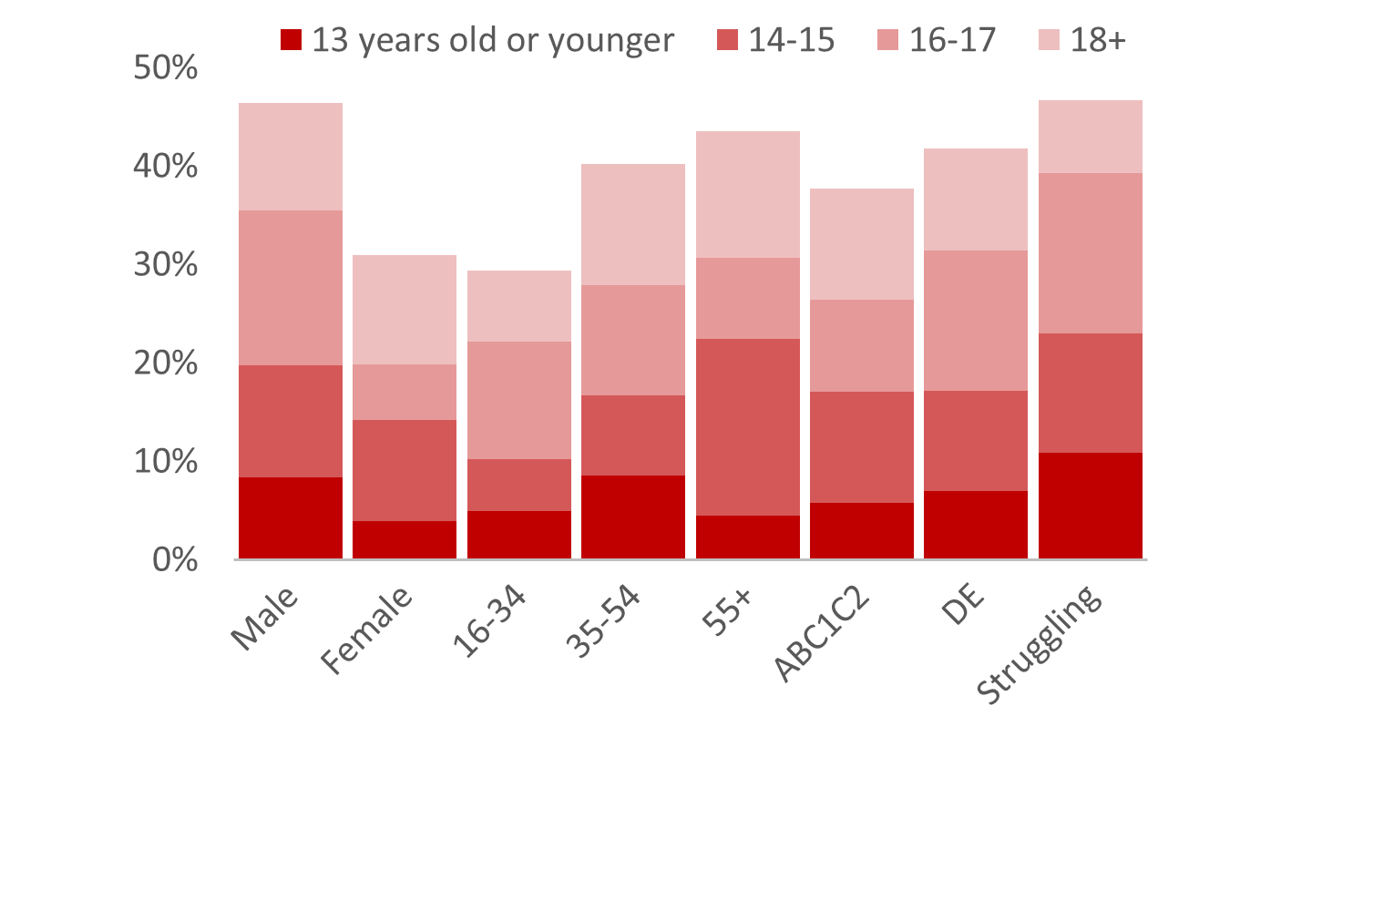
Smoking Habit: Age started smoking and uptake
Age started smoking (those who have ever smoked)
Age started smoking by demographics (all adults)
Uptake of smoking less popular among young adults, as is the proportion starting before leaving school.
Only 28% took up the habit at the legal age of 18 years old (or older)

Slide 7
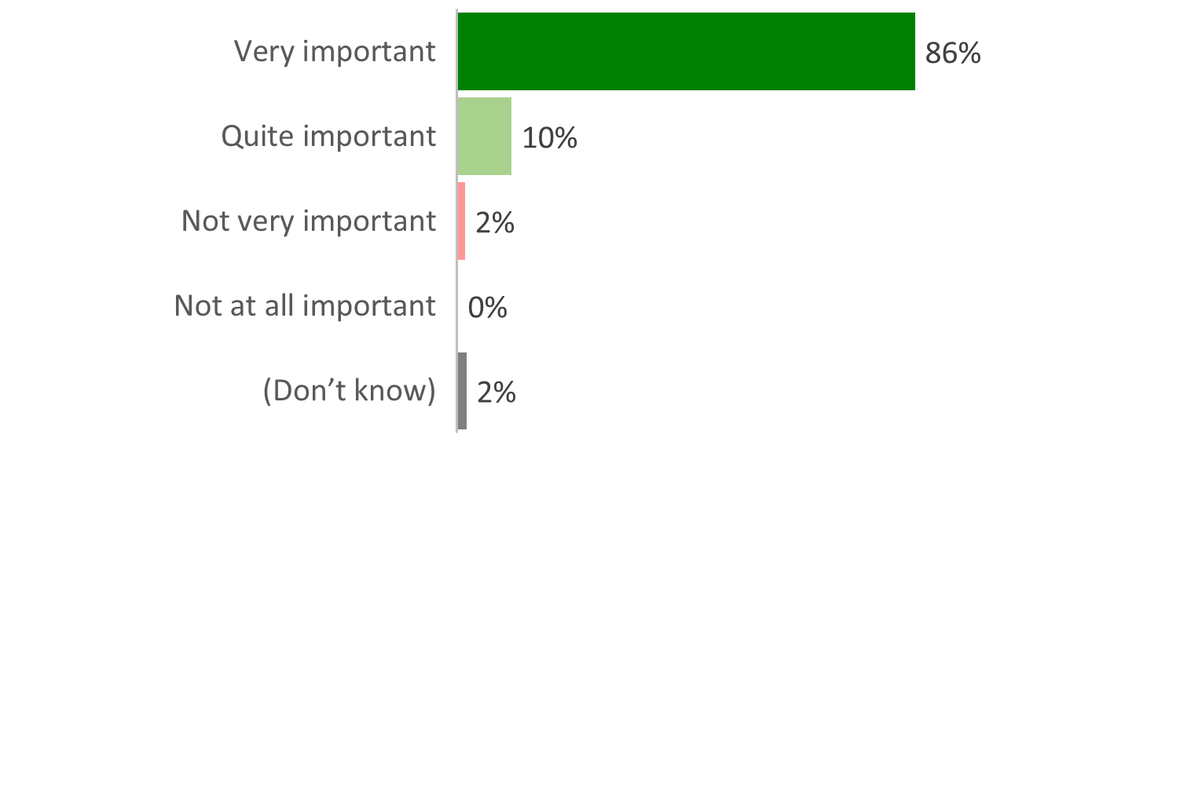
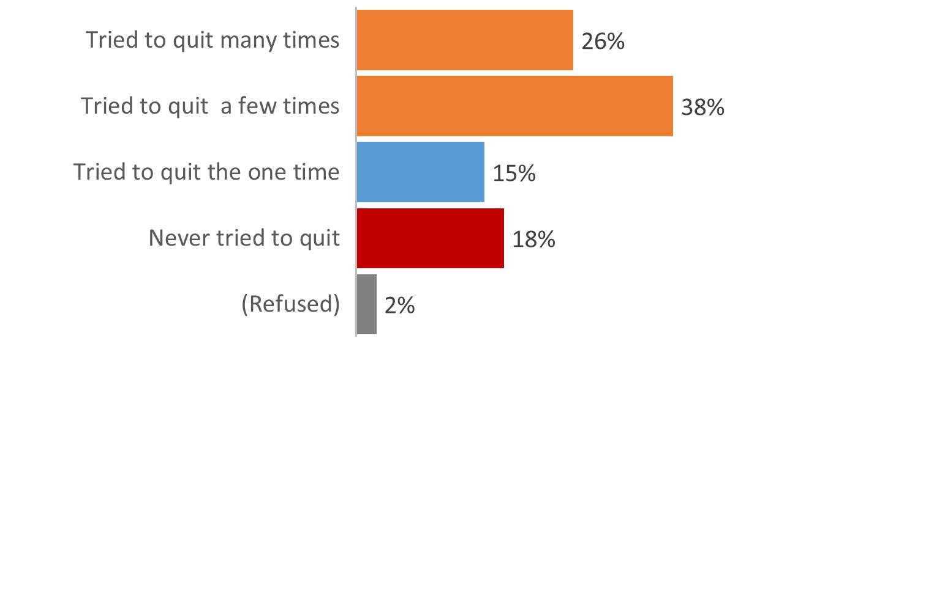
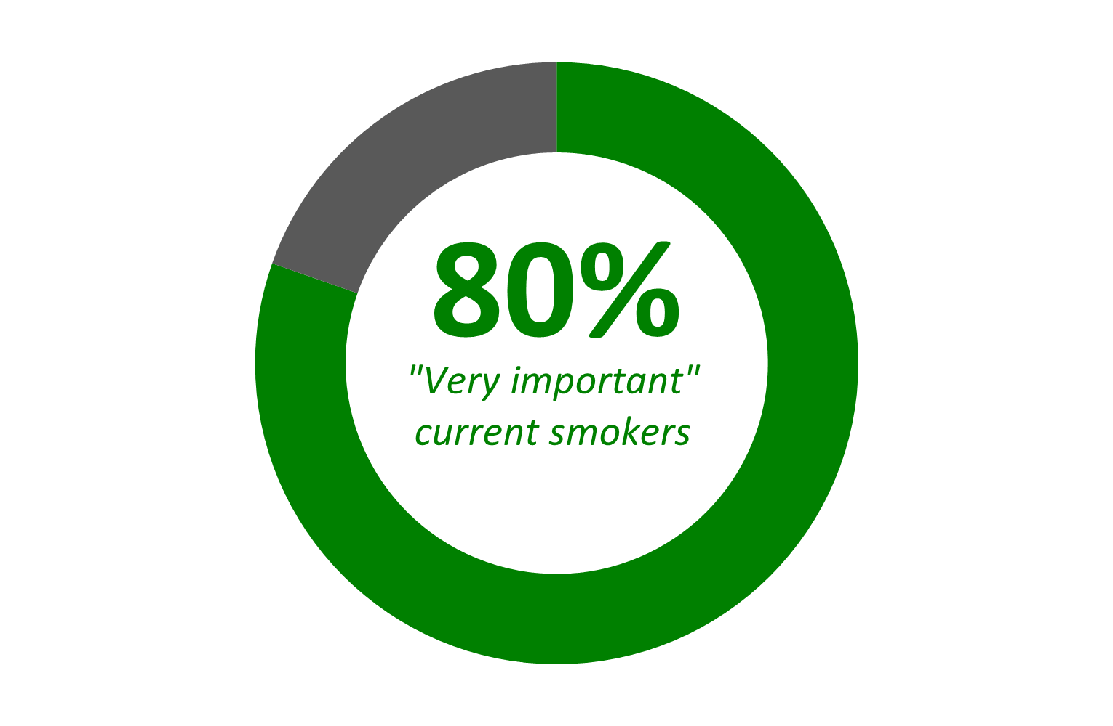
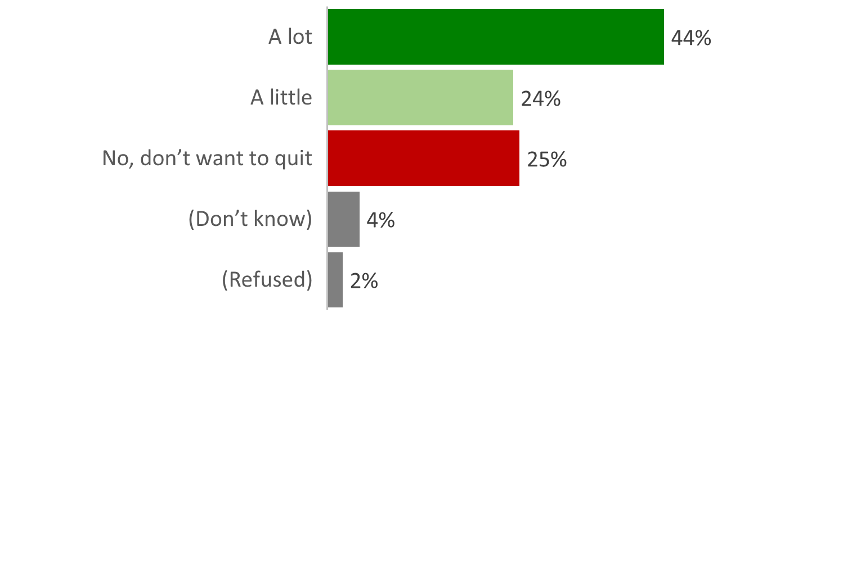
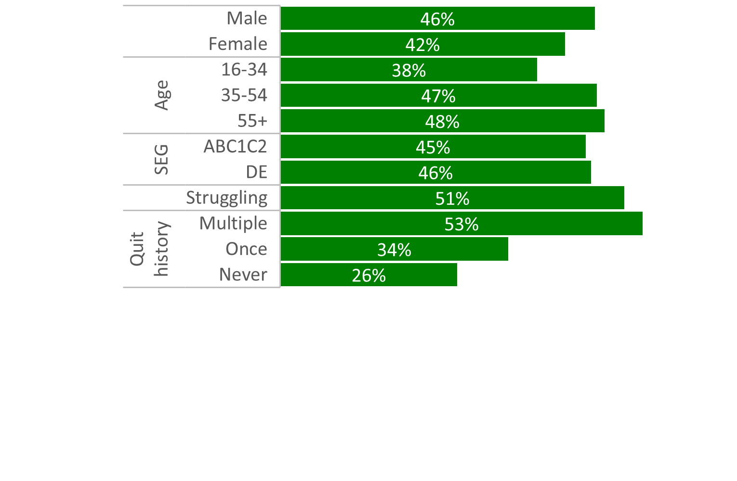
Smoking Habit: Attitudes & Quitting
Importance placed on a child not smoking (all adults)
Past quit attempts (current smokers)
Desire to quit (current smokers)
Desire to quit among sub-groups (% a lot)

Slide 8
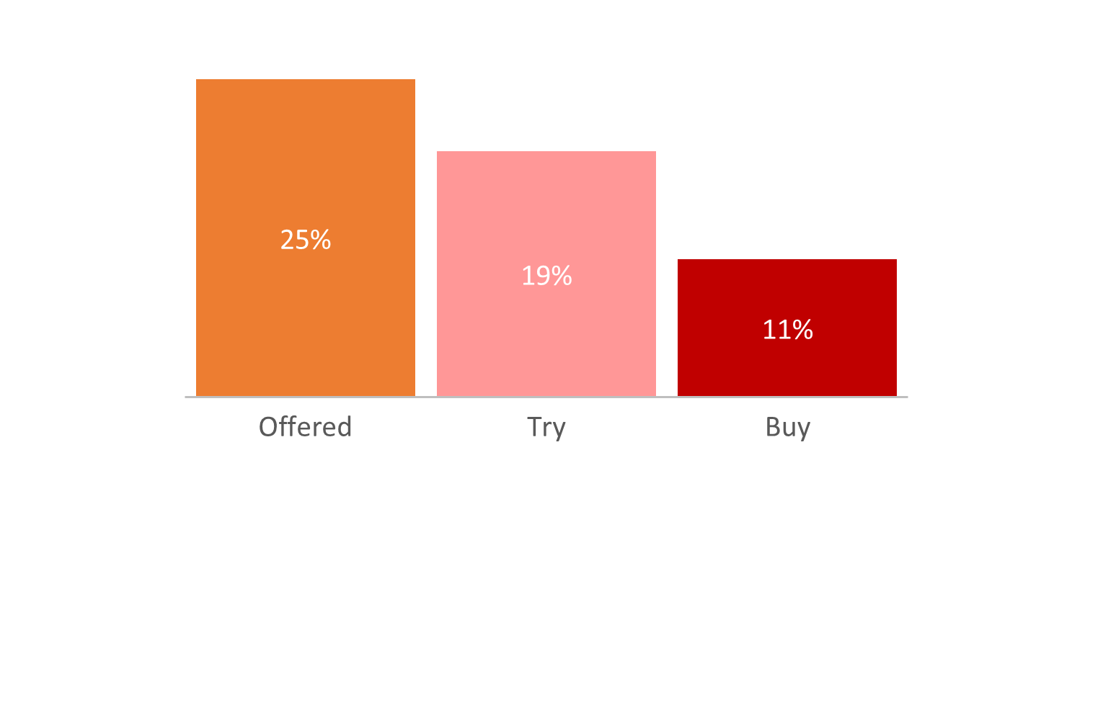
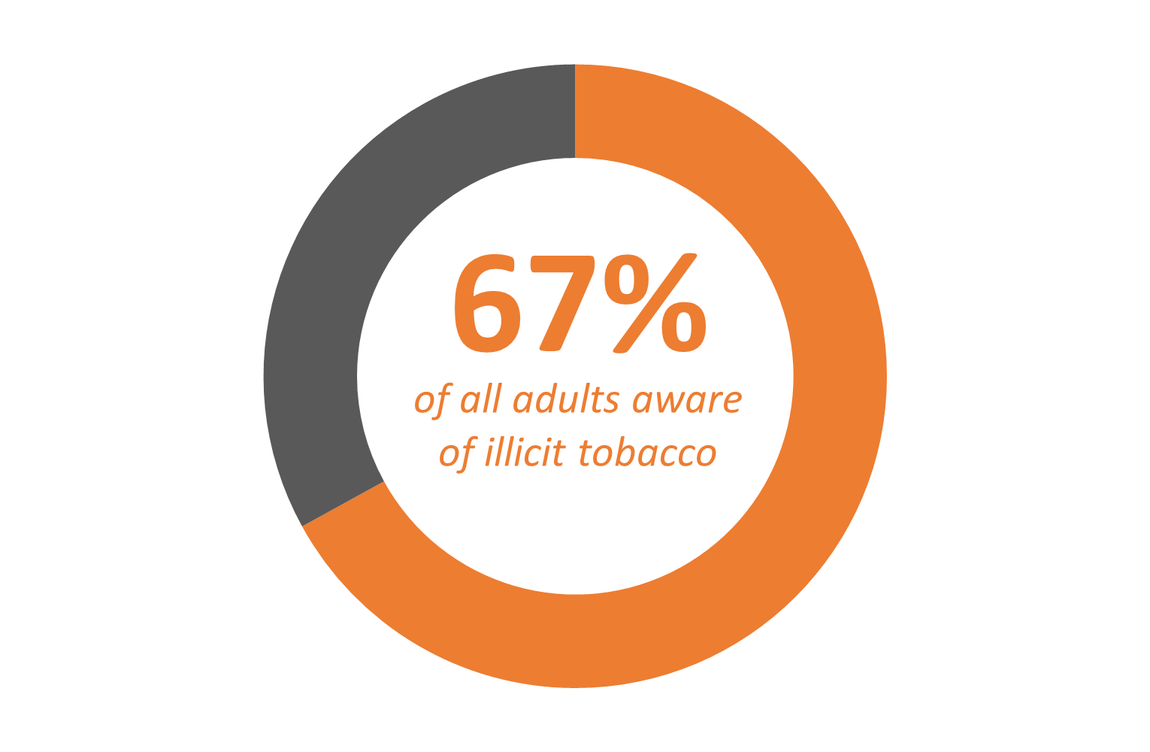
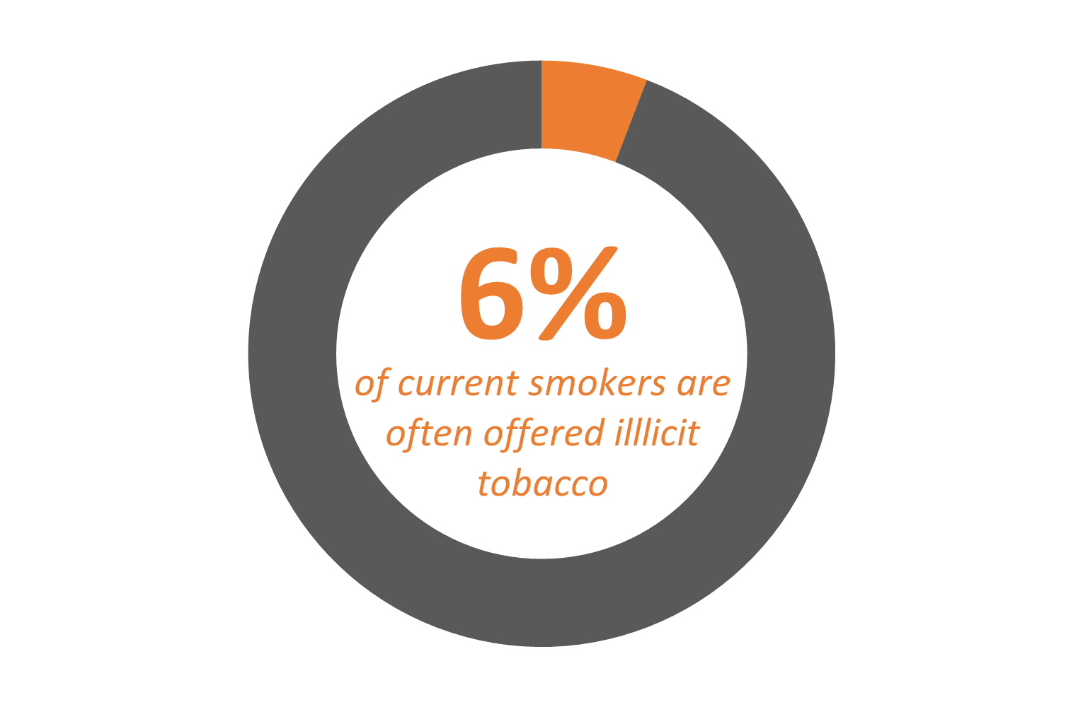
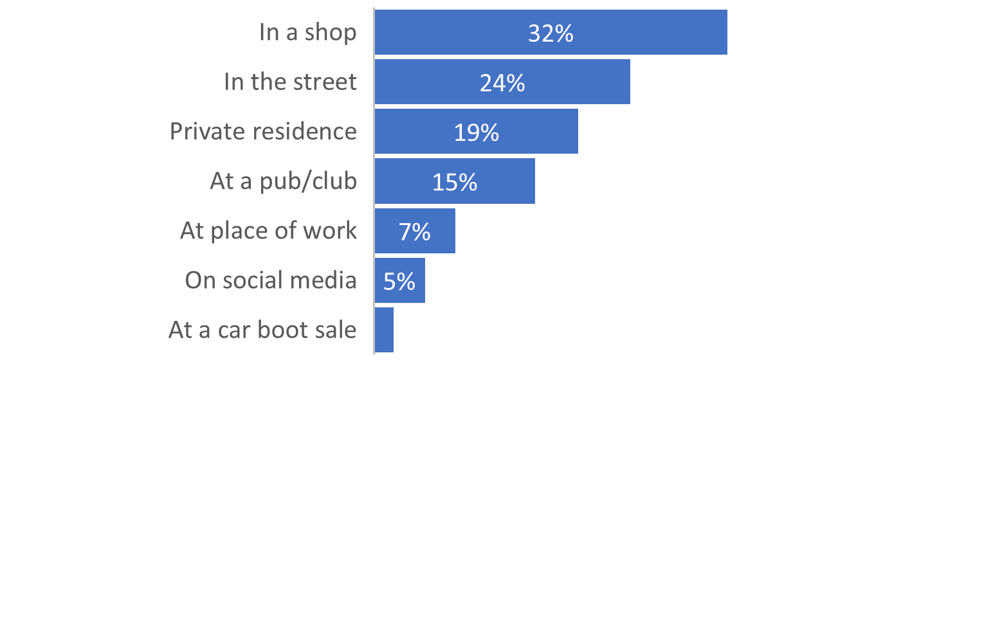
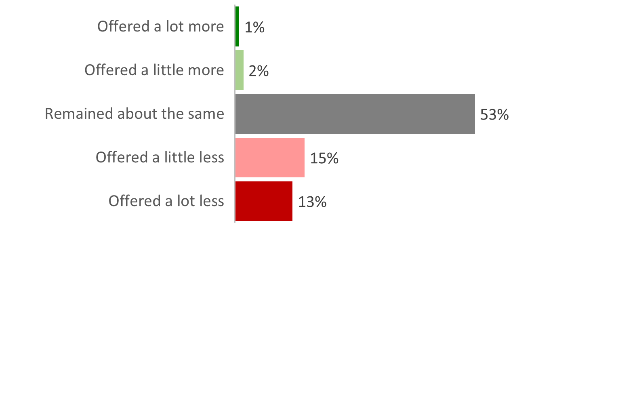
Illicit tobacco offers, trying and buying
Aware of illicit tobacco
Current smokers offered, trying and buying illicit tobacco
Illicit tobacco offers
Is illicit tobacco being offered more or less in 2021 (those ever offered)
Venues of illicit tobacco offers (% of those offered)
Illicit tobacco offers compared to 12 months ago

Slide 9
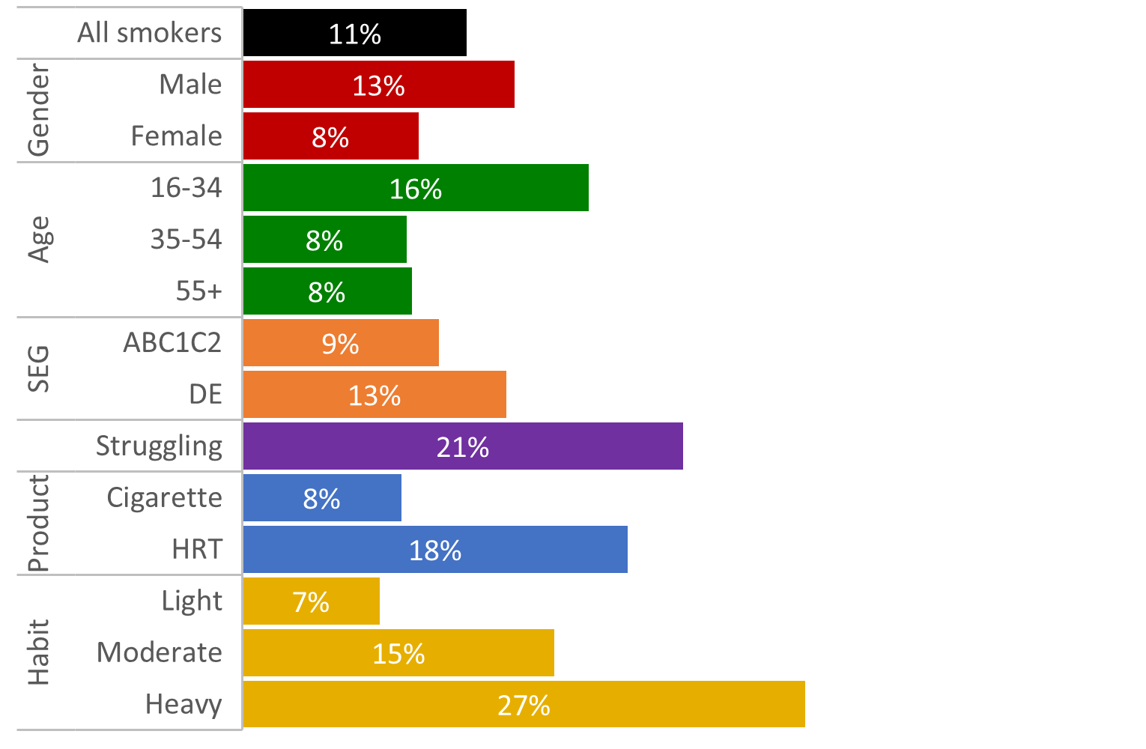
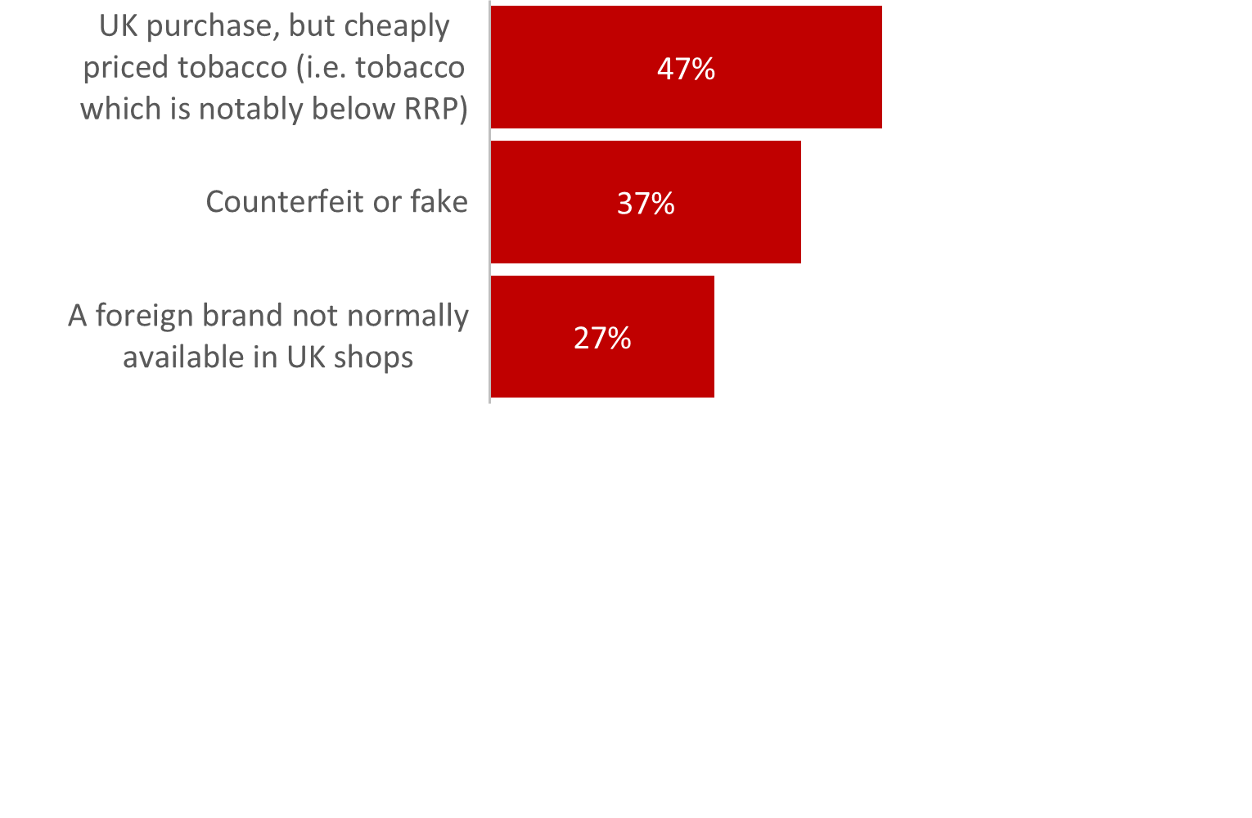
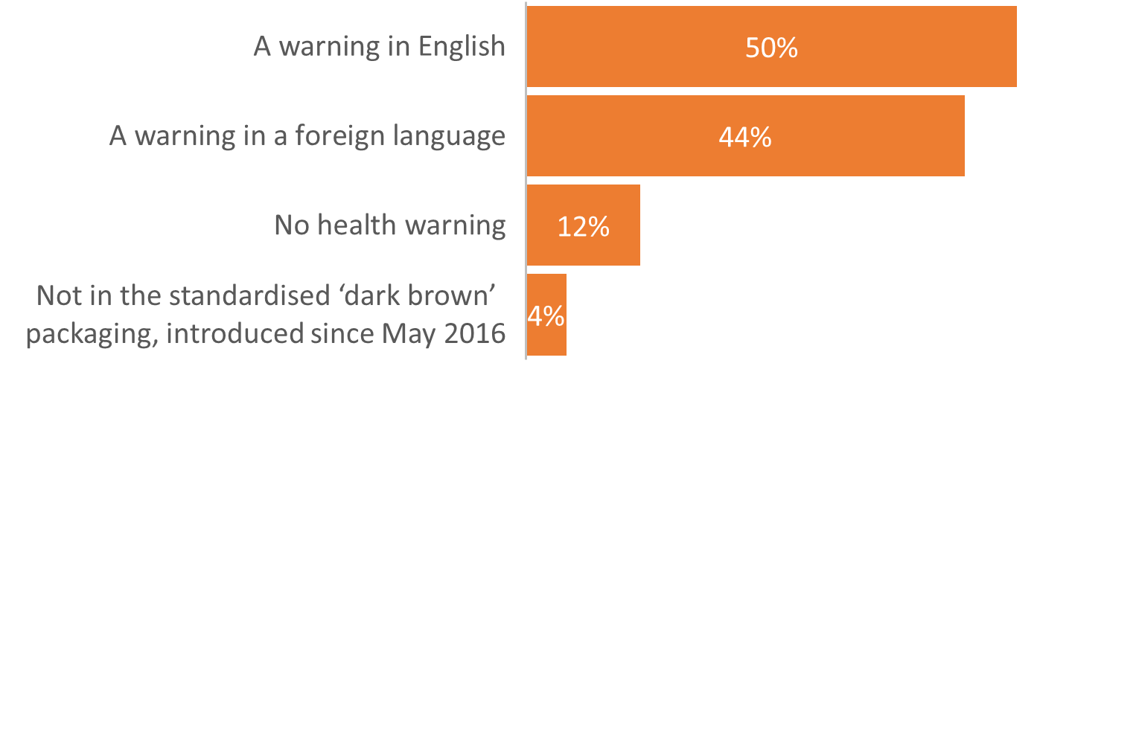
Illicit tobacco prevalence
Illicit tobacco purchase prevalence among smokers
Types of illicit tobacco being bought (illicit buyers)
Description of illicit tobacco packaging (illicit buyers)

Slide 10
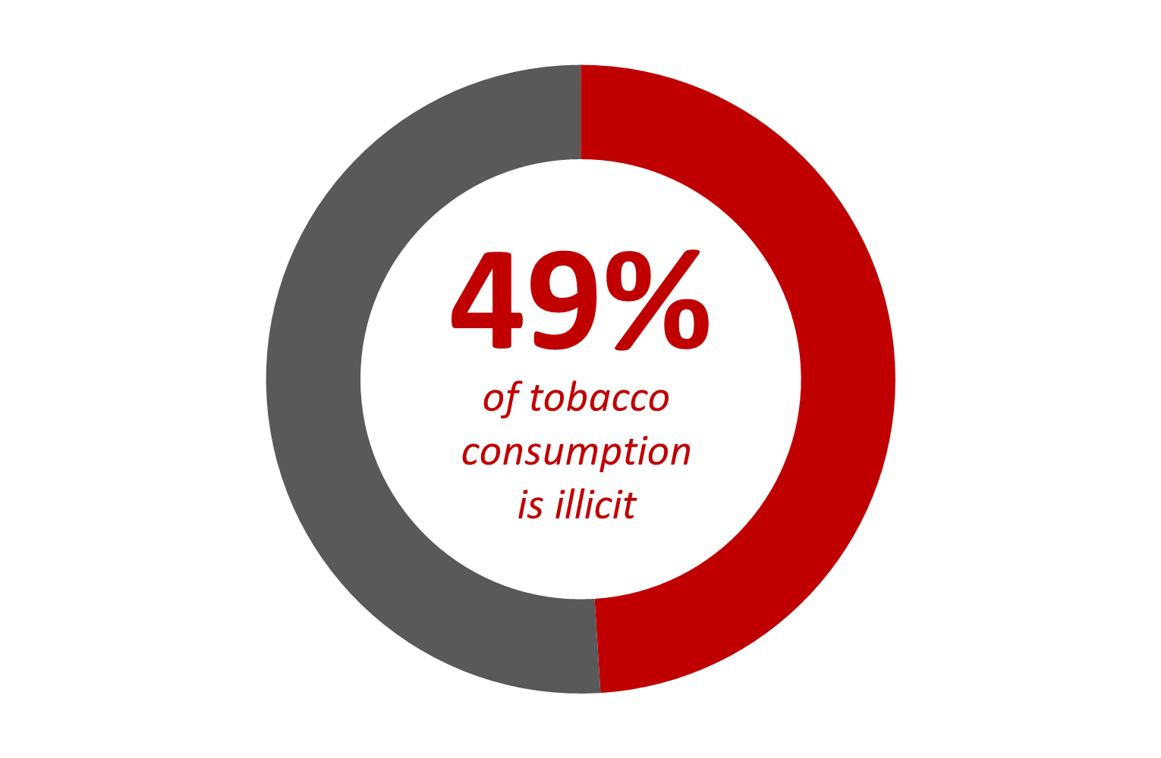
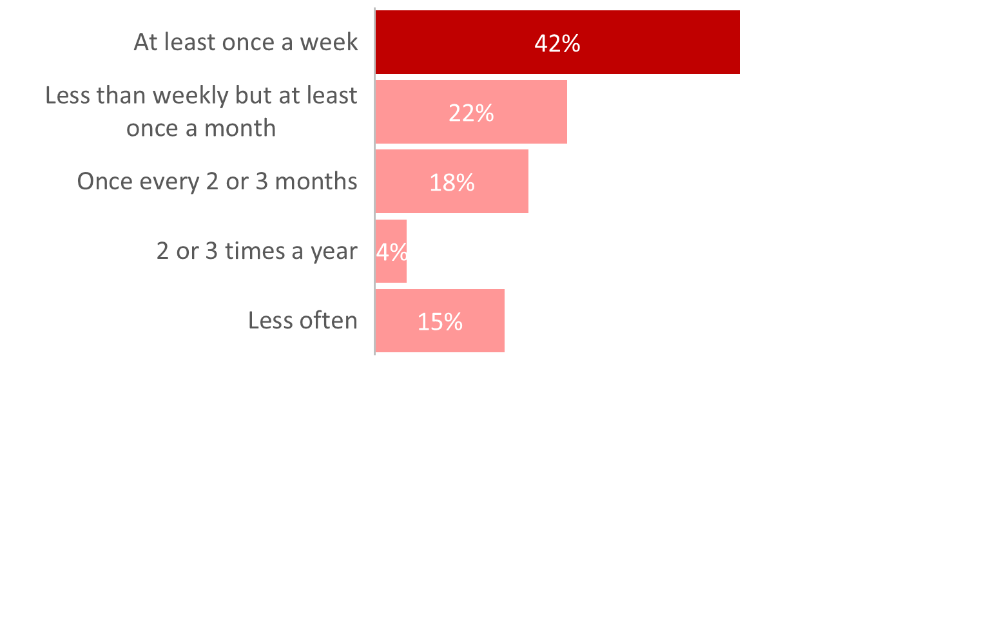
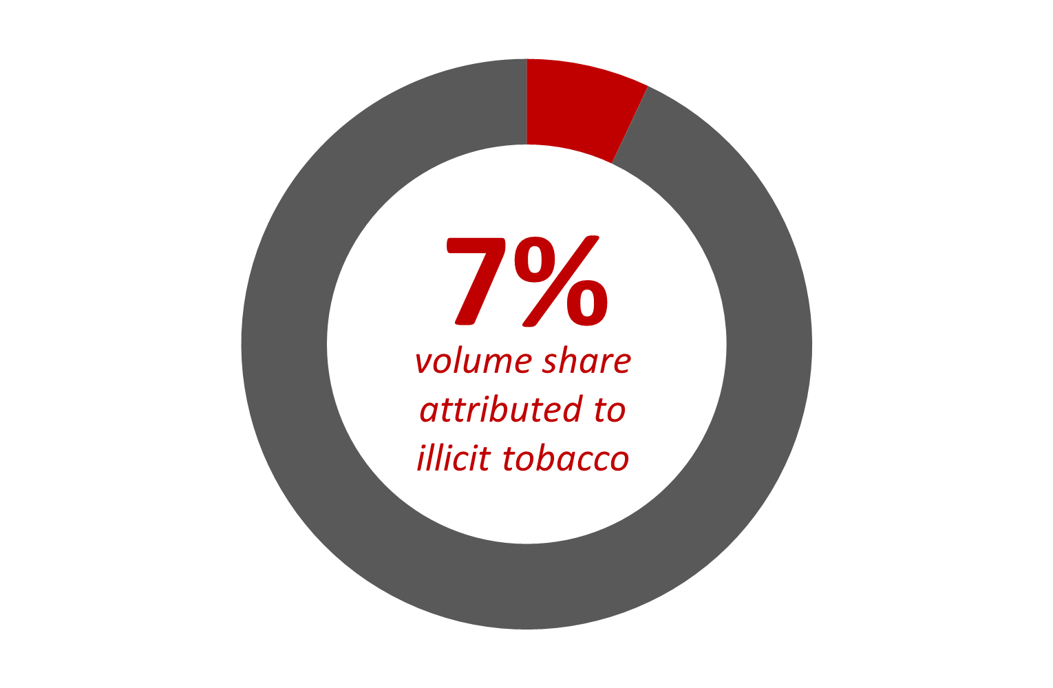
Proportion of illicit tobacco being smoked
How much illicit tobacco do buyers consume?
How often is illicit tobacco being bought?
For 1 in 6 buyers, illicit
accounts for 90-100%
of tobacco smoked
For 1 in 20 illicit accounts
for less than 10% of
tobacco smoked
York City illicit tobacco market share
Key Figures: Illicit tobacco volume
2,500 buyers across the authority area
Purchasing 7.1m illicit cigarettes per year
worth £1.5m illicit street value
Estimated £3m annual duty loss
Volume share for the
North East has typically
been between 9-12%
since 2015

Slide 11
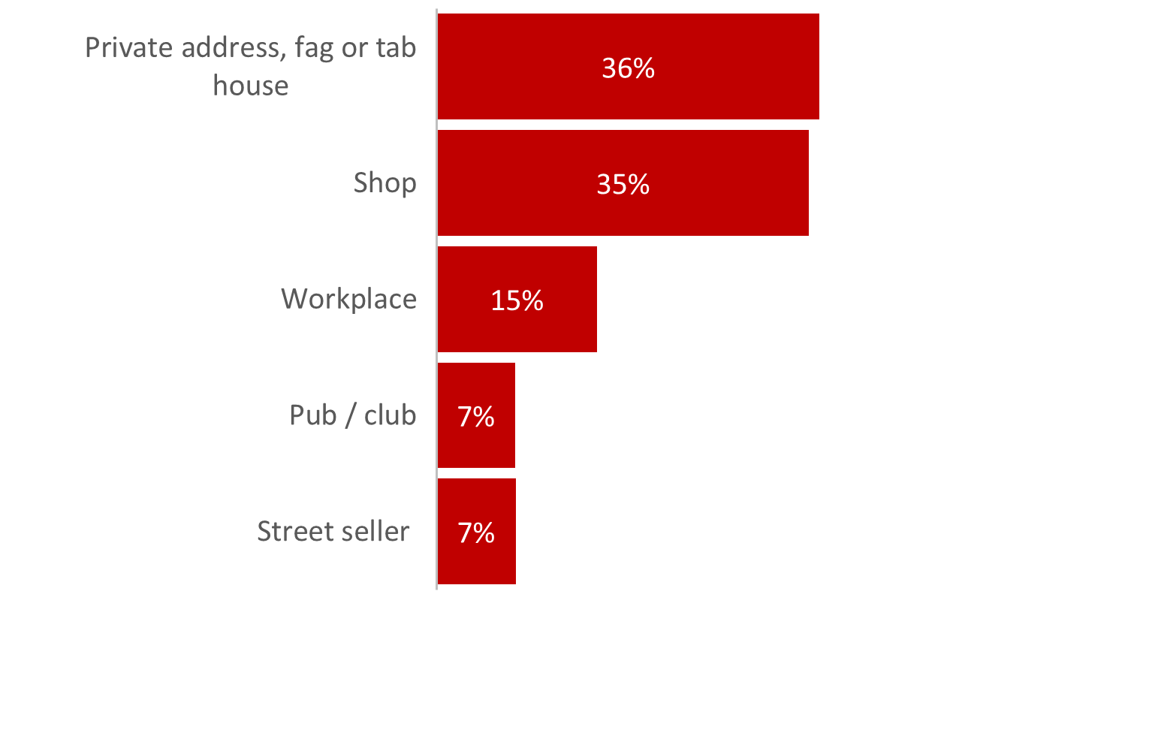
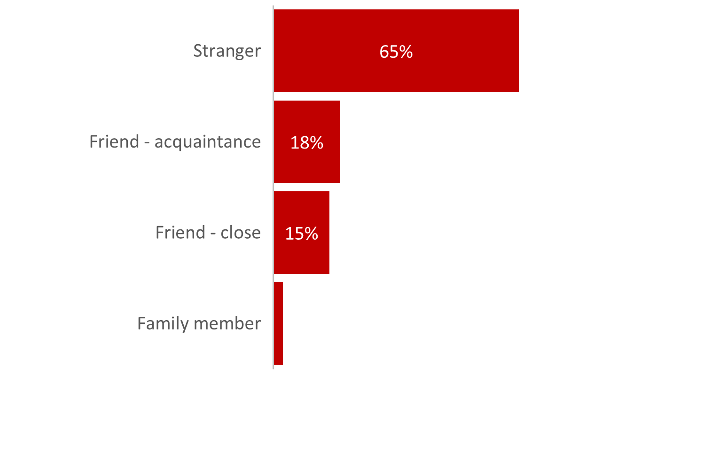
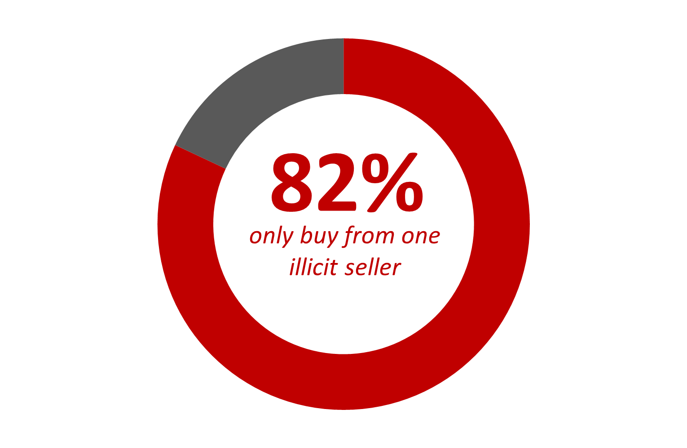
Illicit tobacco purchasing
Illicit tobacco channels of purchase
Relationship with illicit seller
Number of illicit sellers bought from
Popular illicit brands / pricing
Cigarettes:
Richmond / Lambert & Butler
£4.50 per pack of 20 (£10.25 RRP)
Hand-rolling tobacco:
Drum / Amber Leaf
£11.50 per 50g pouch (£25.80 RRP)

Slide 12
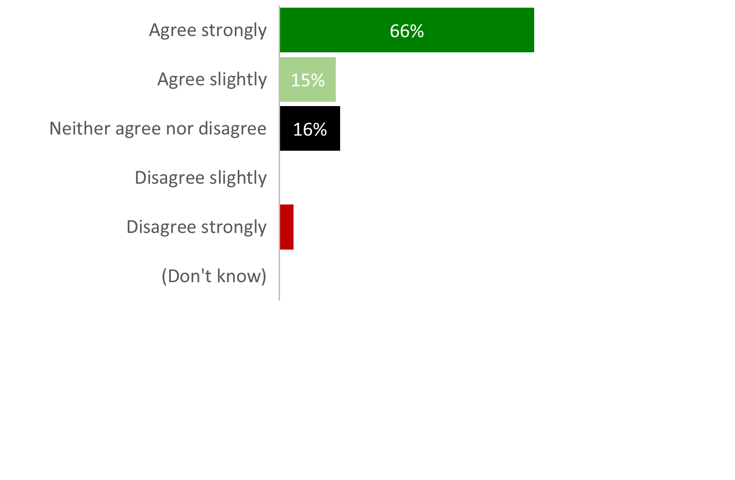
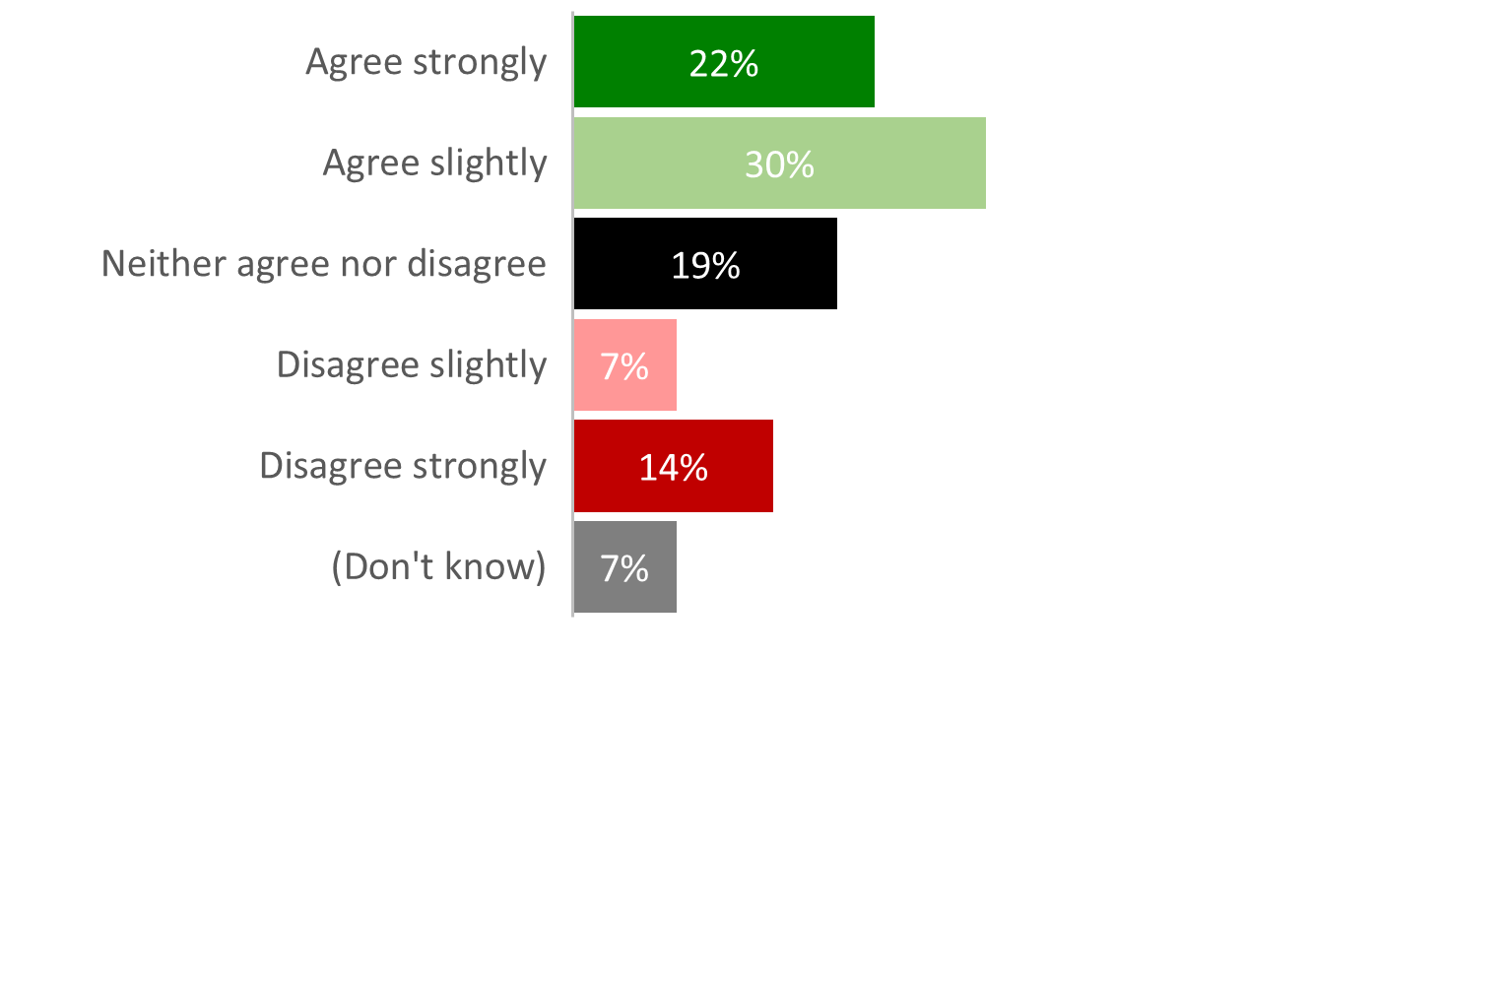
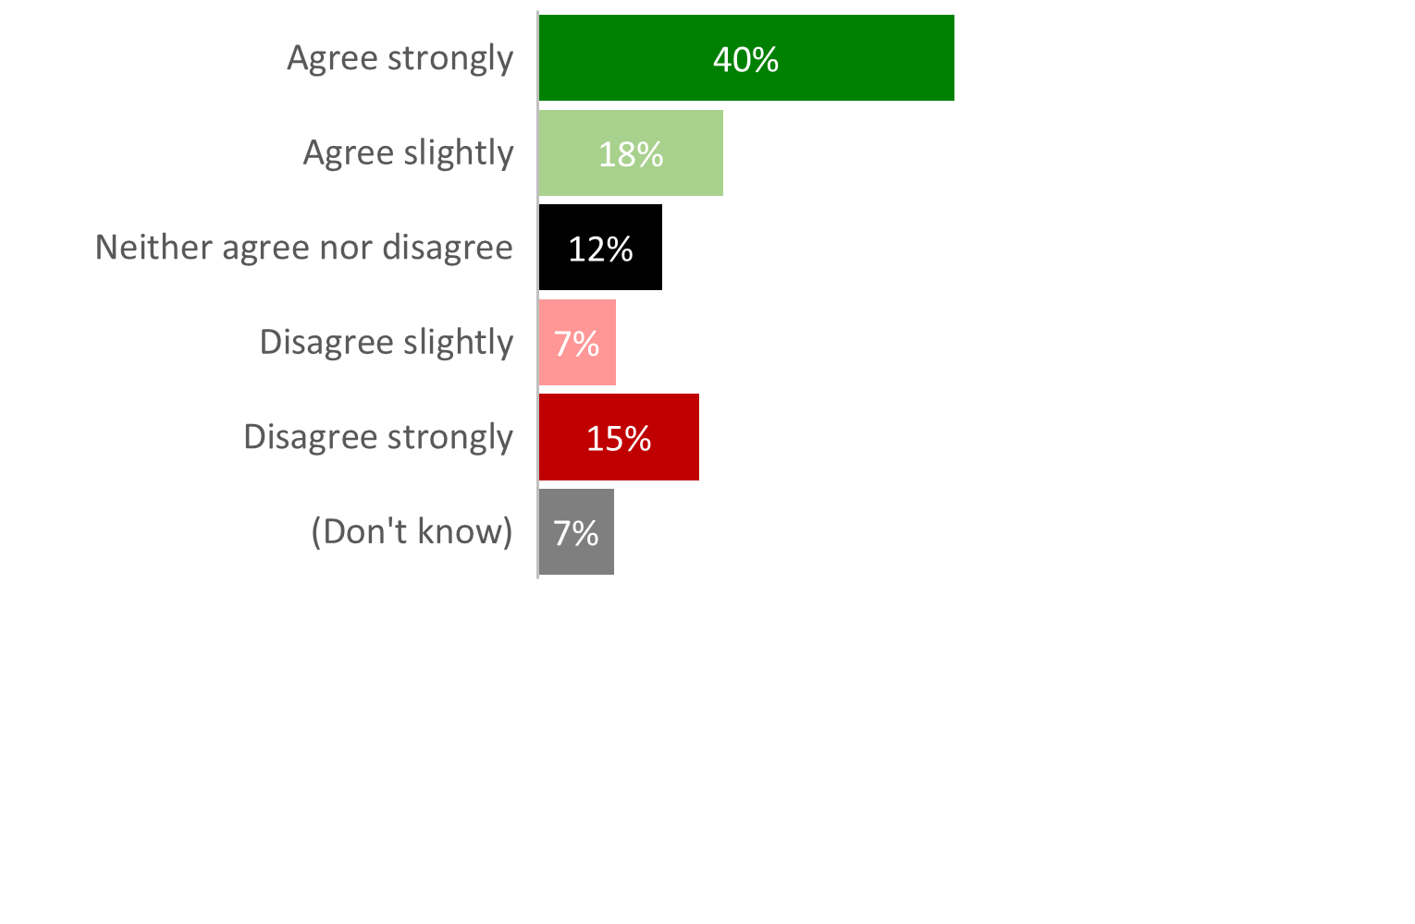
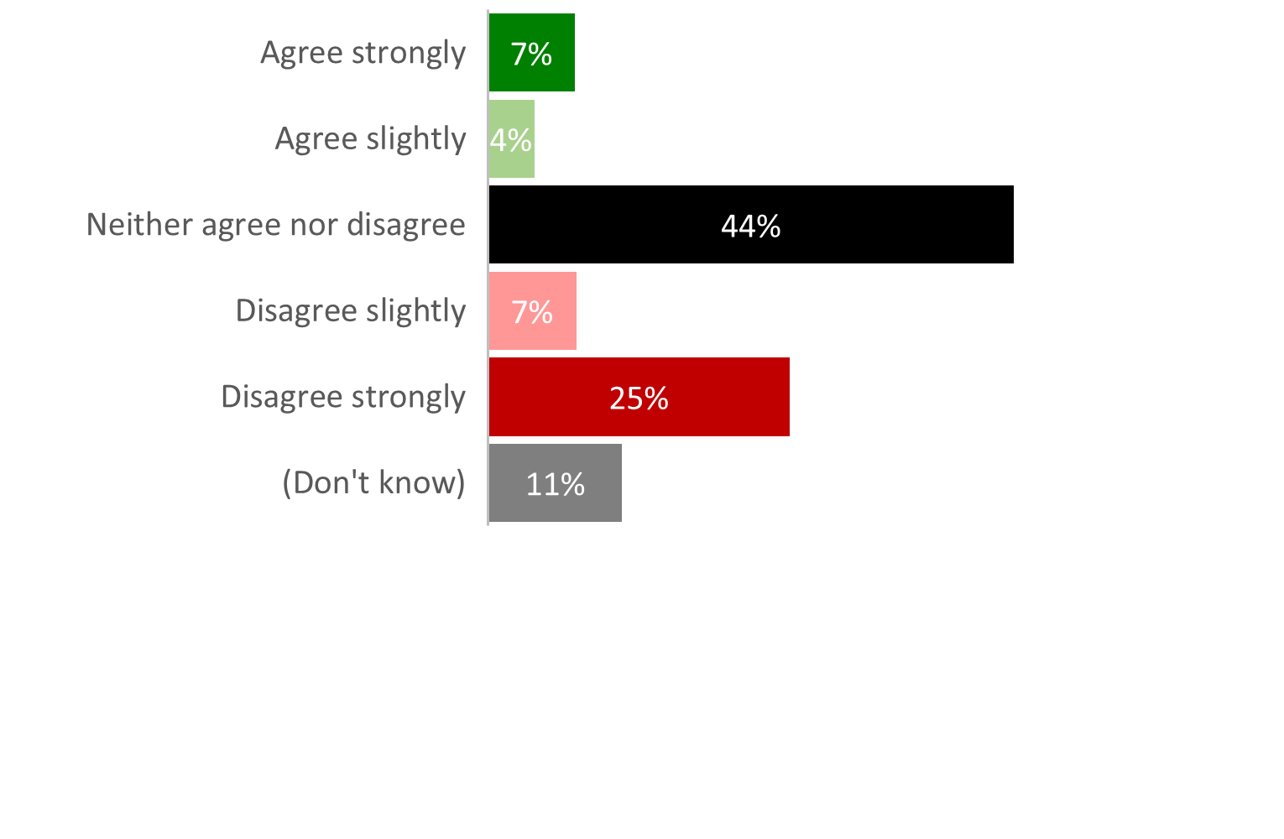
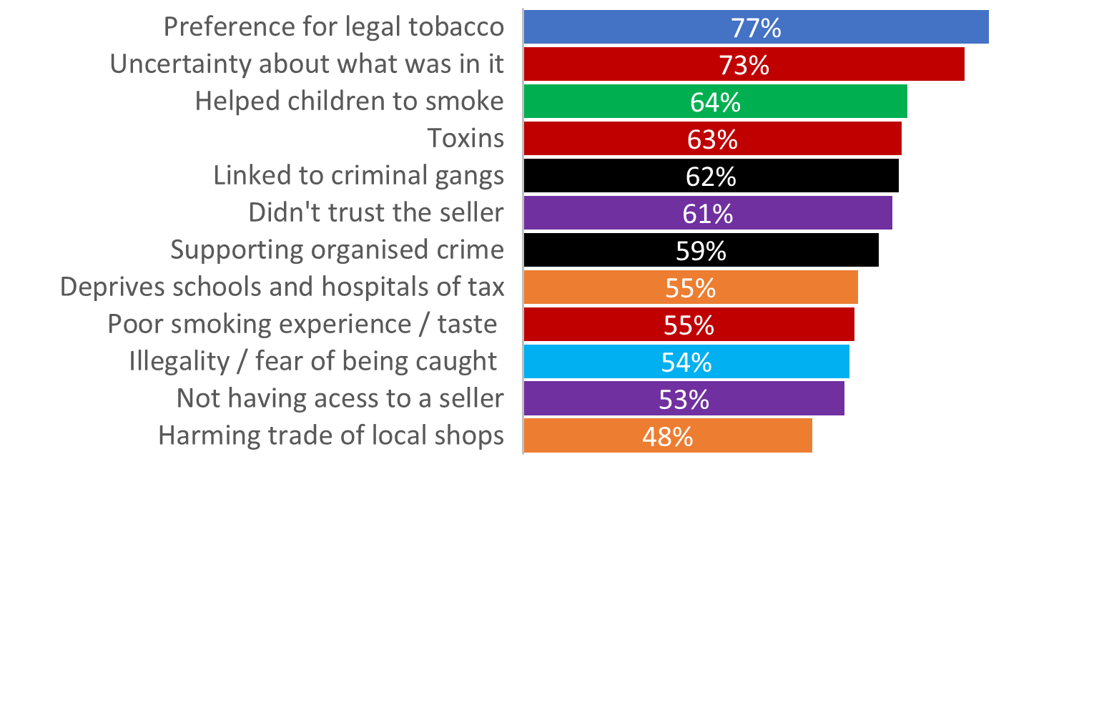
Illicit tobacco buyer motivations
Facilitates the habit
Social norm (i.e. everyone does it)
Convenience of purchase
Does illicit tobacco make quitting harder?
Barriers to illicit tobacco purchase (% Agree)

Slide 13
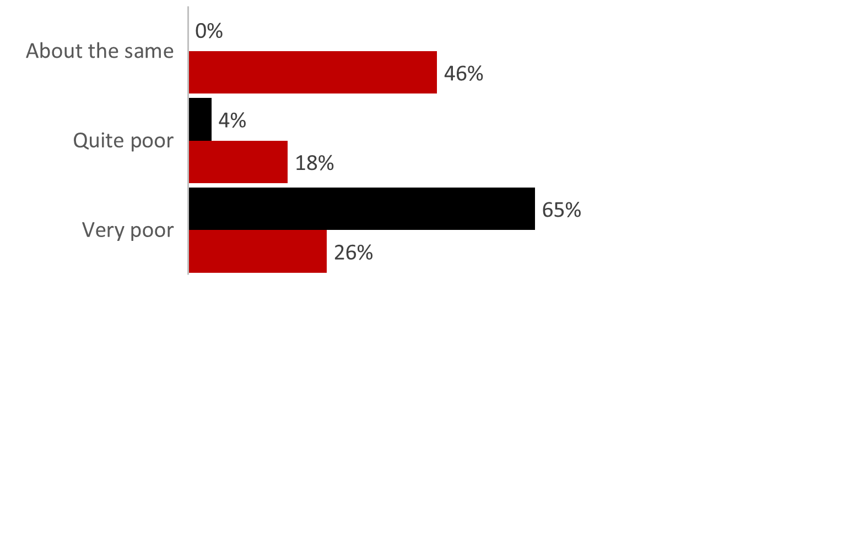
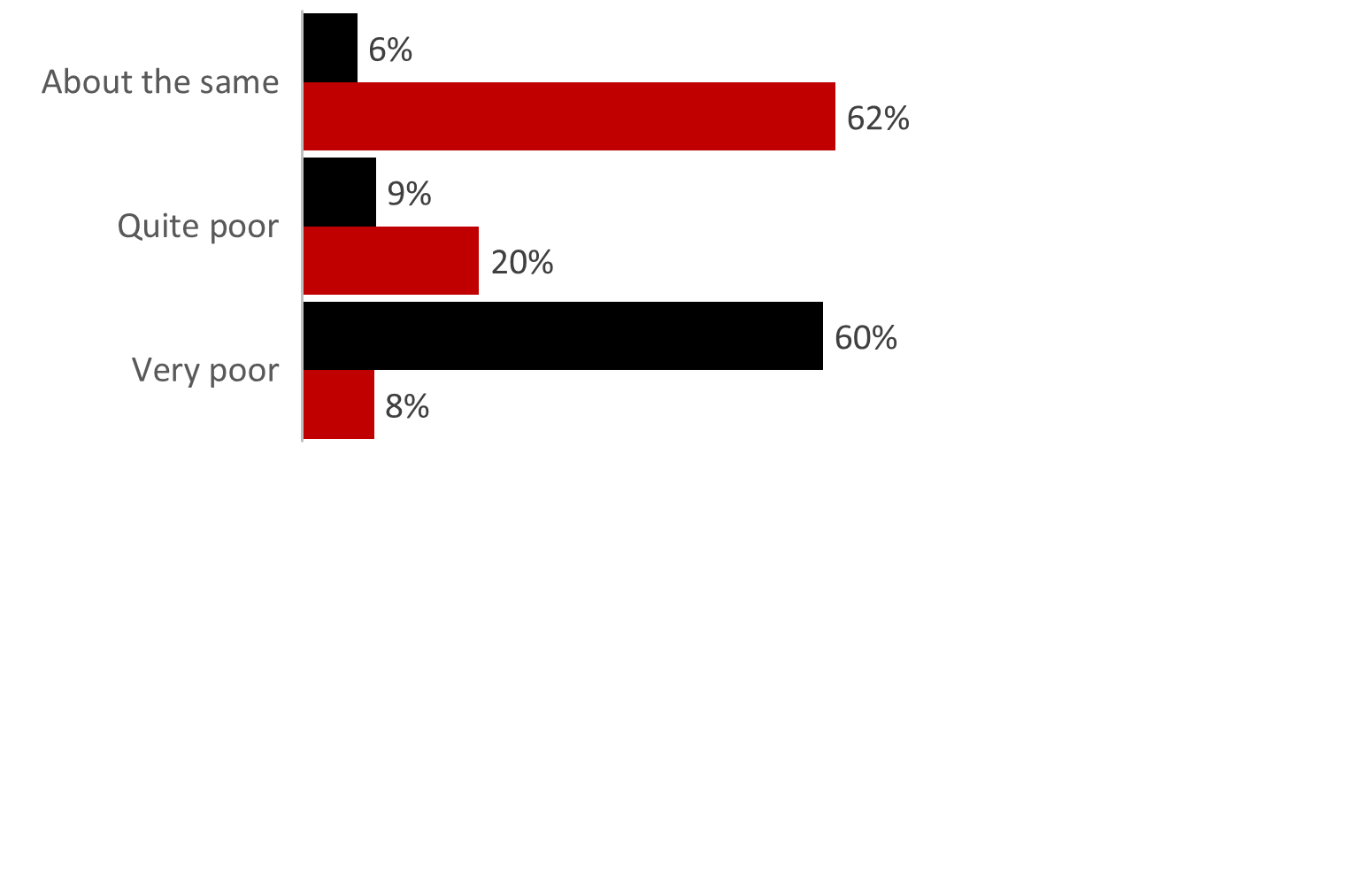
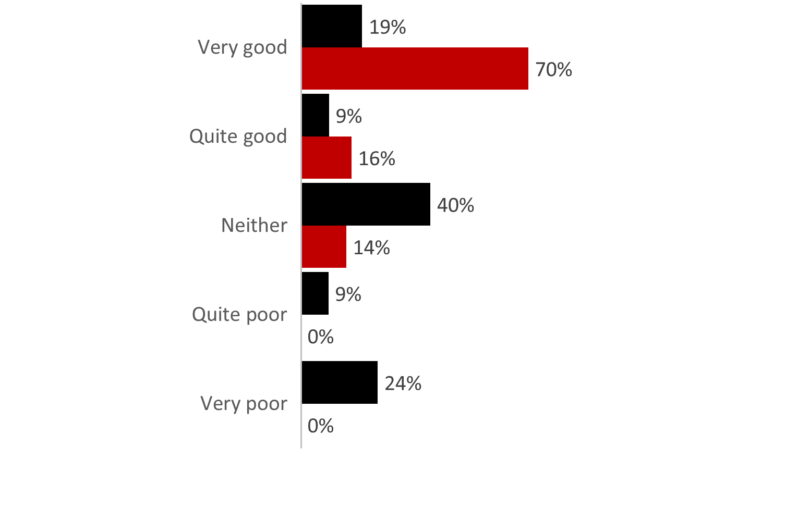
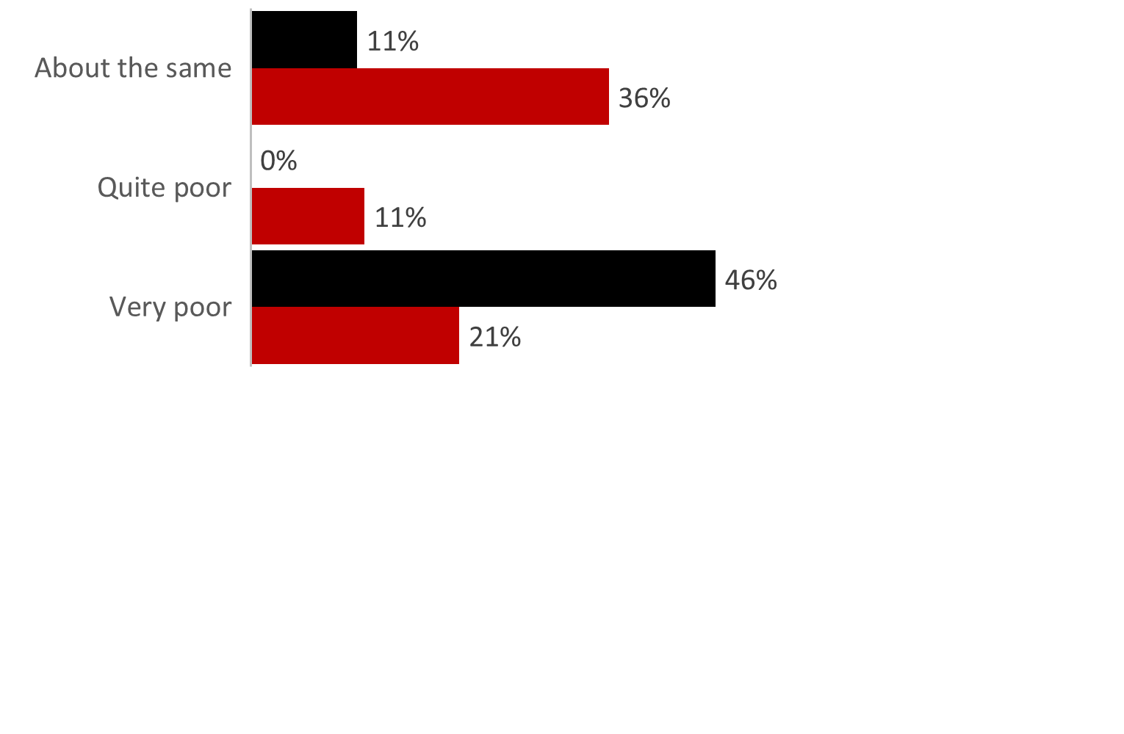
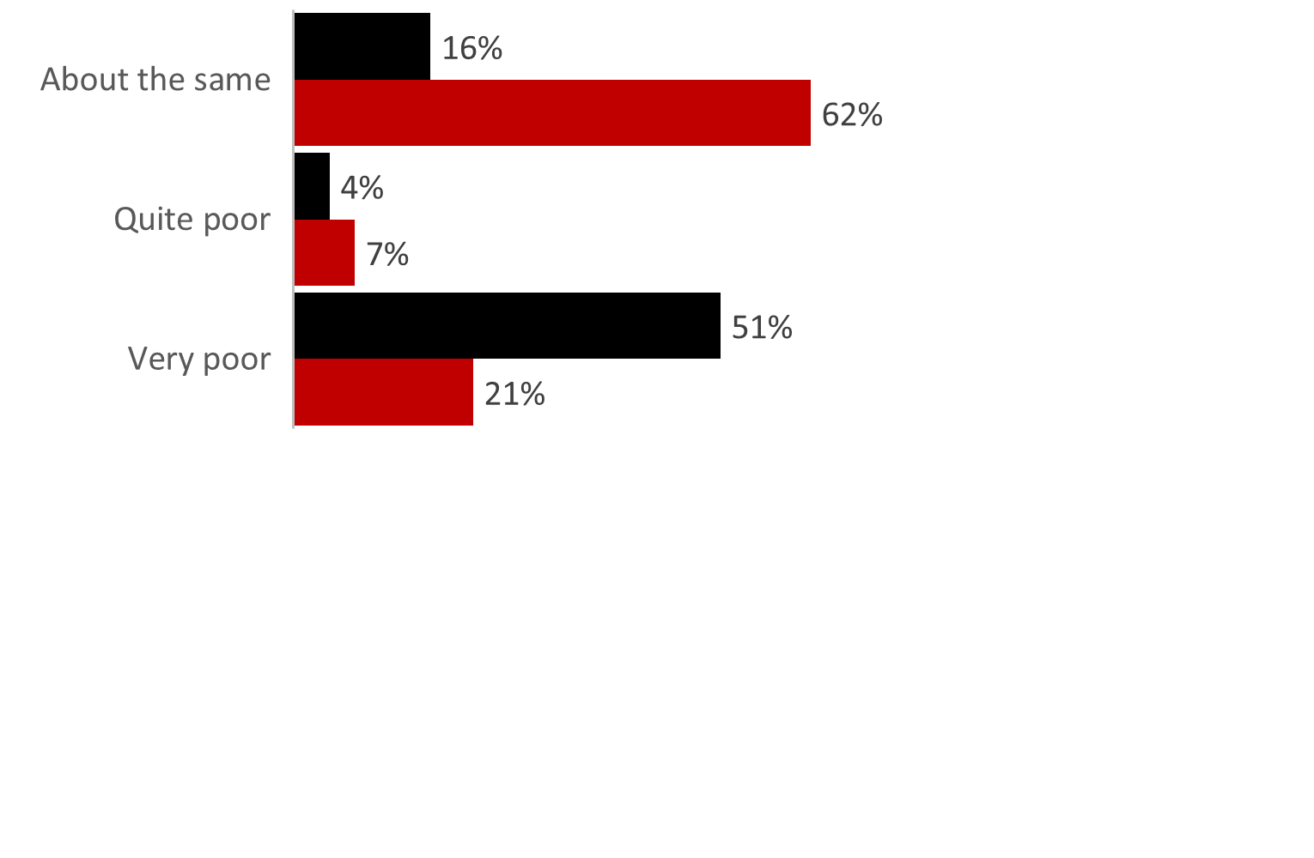
Illicit tobacco product attitudes
Illicit vs Legitimate: Taste
Illicit vs Legitimate: Experience
Value for money
Illicit vs Legitimate: Impact on health
Illicit vs Legitimate: After effects
Illicit tobacco rejectors
Illicit tobacco buyers

Slide 14
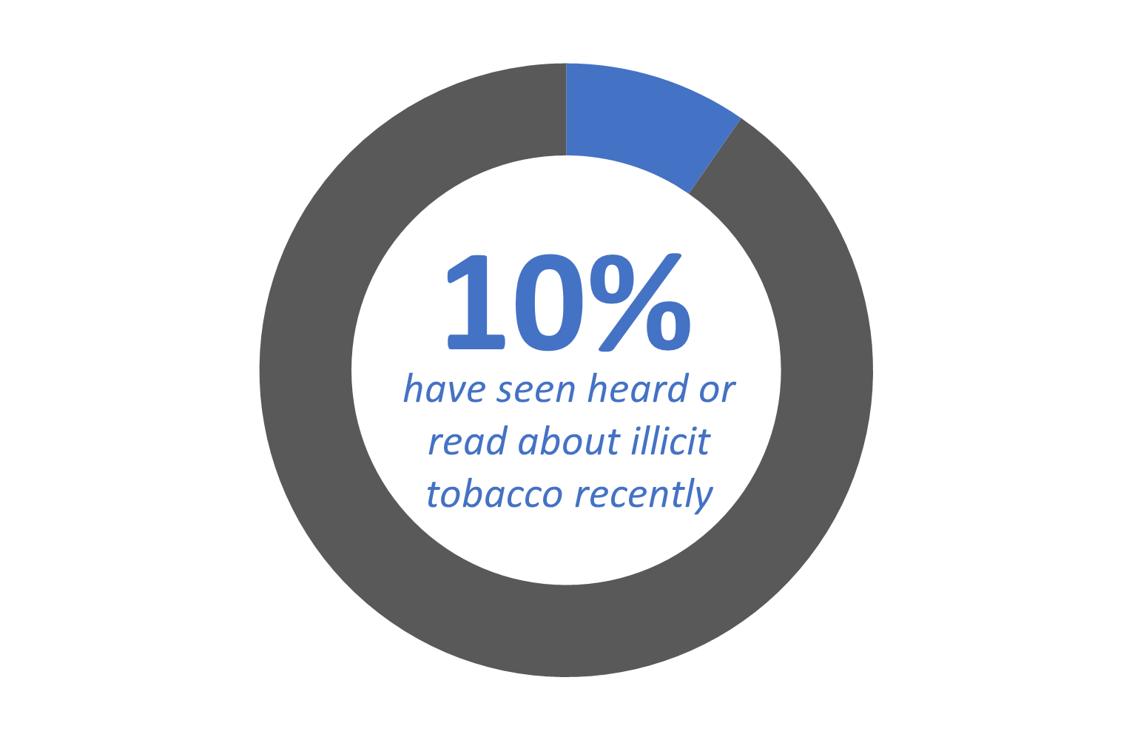
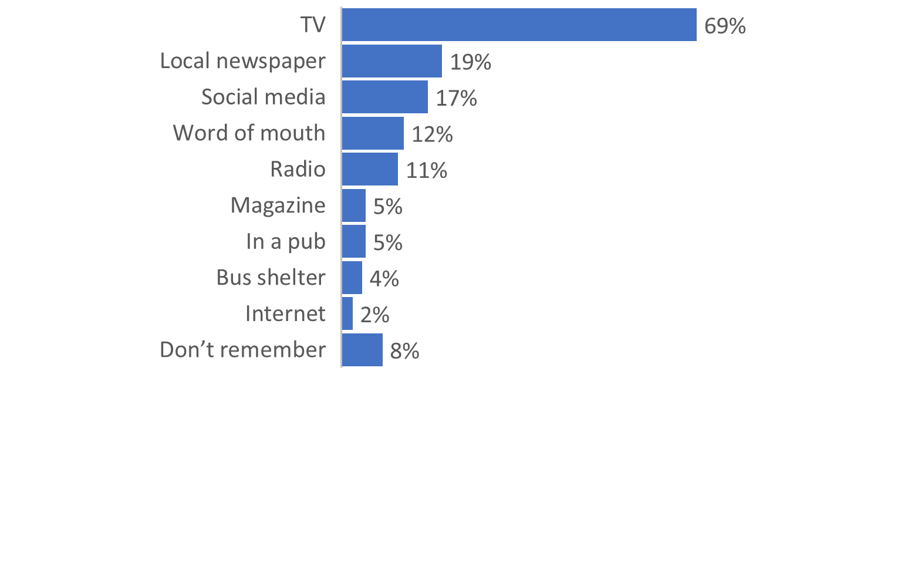
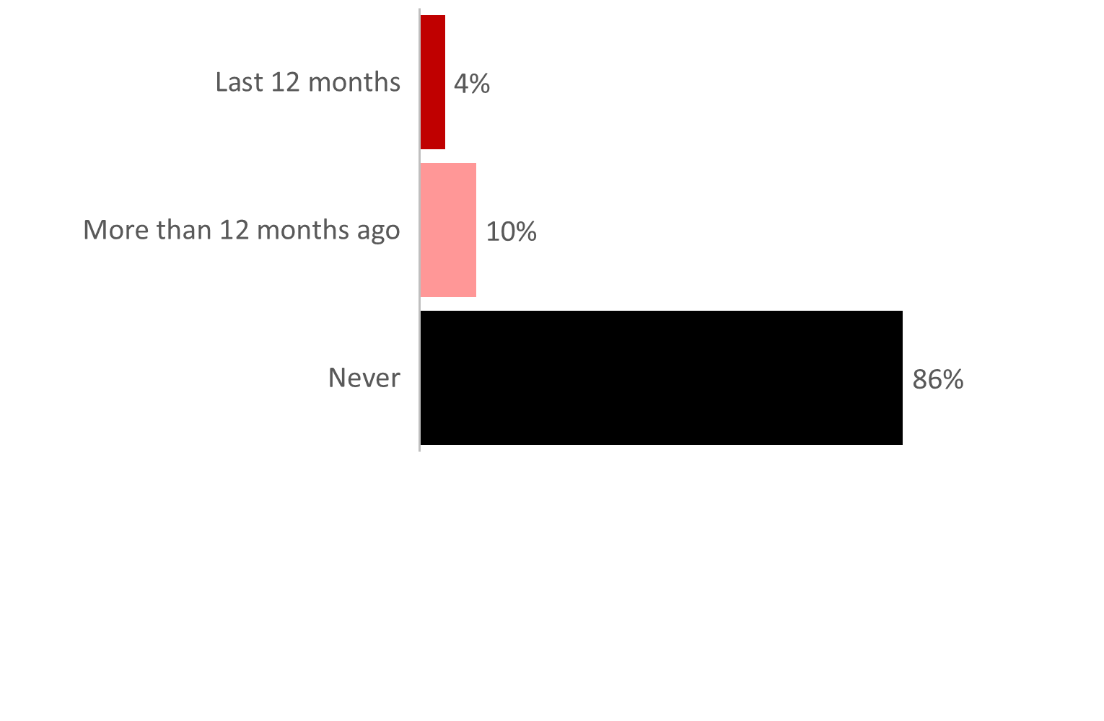
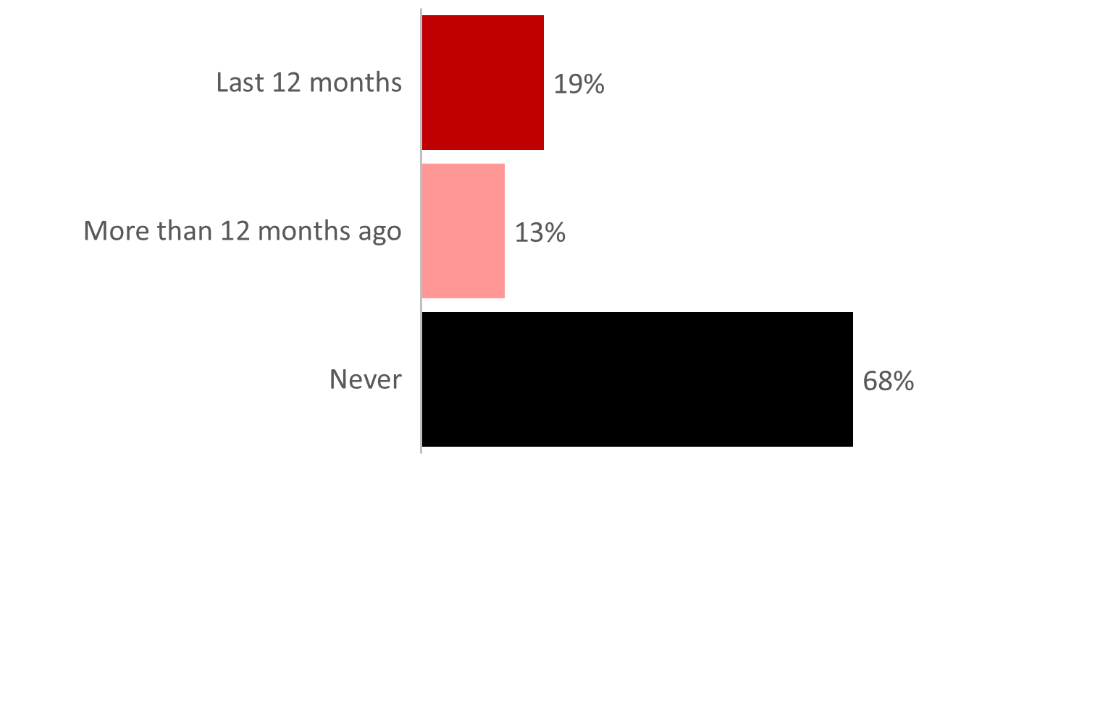
Illicit tobacco awareness and encounters
Illicit tobacco awareness
Illicit tobacco campaign awareness
Campaign recall channels
Encounters with illicit tobacco (non-smokers)
Encounters with illicit tobacco (smokers)

Slide 15
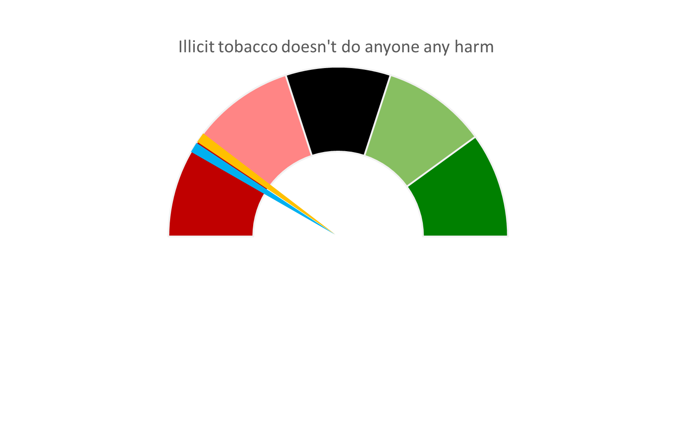
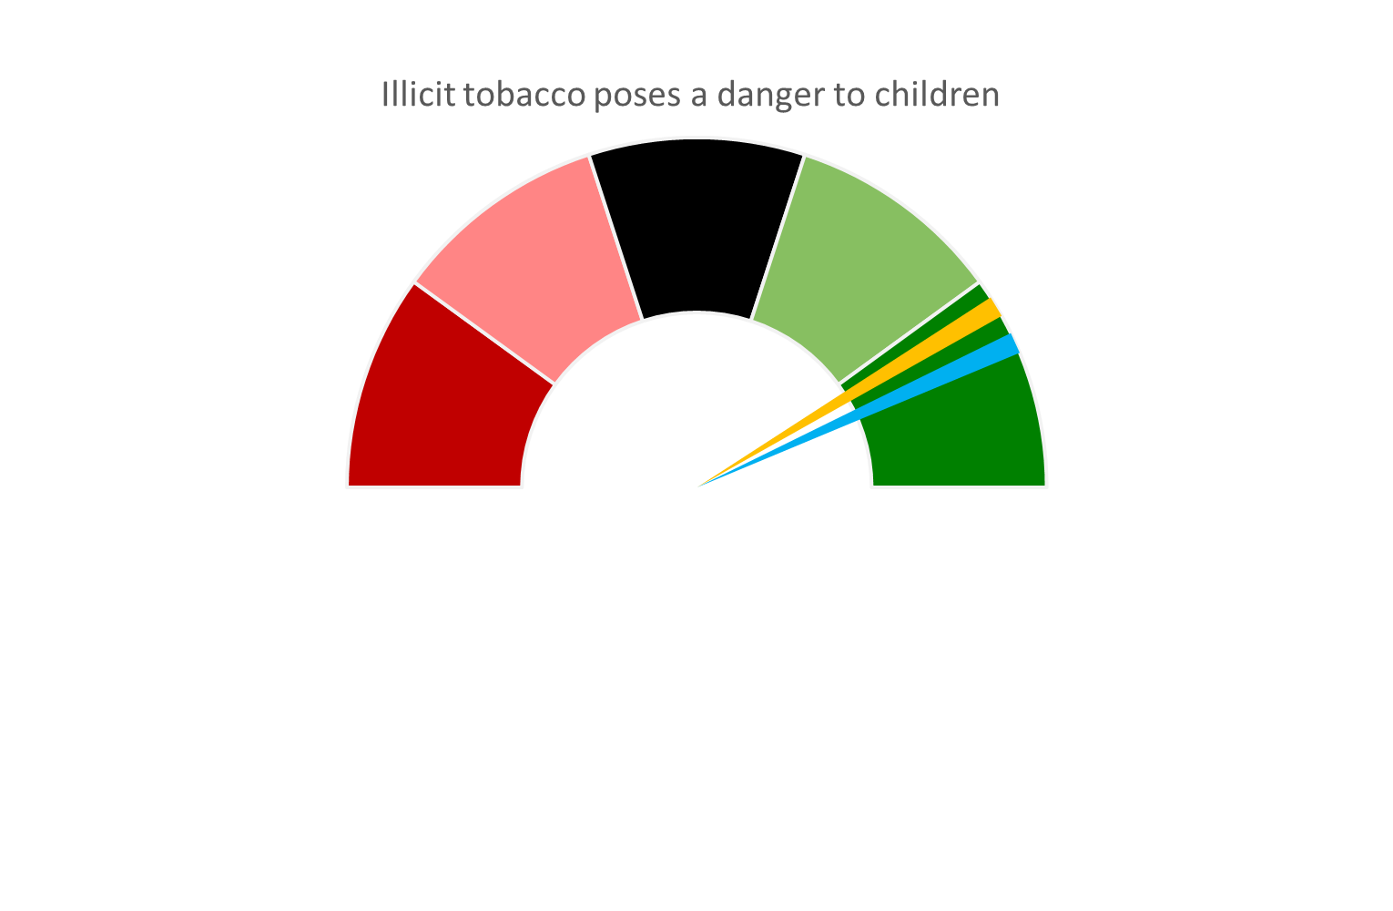
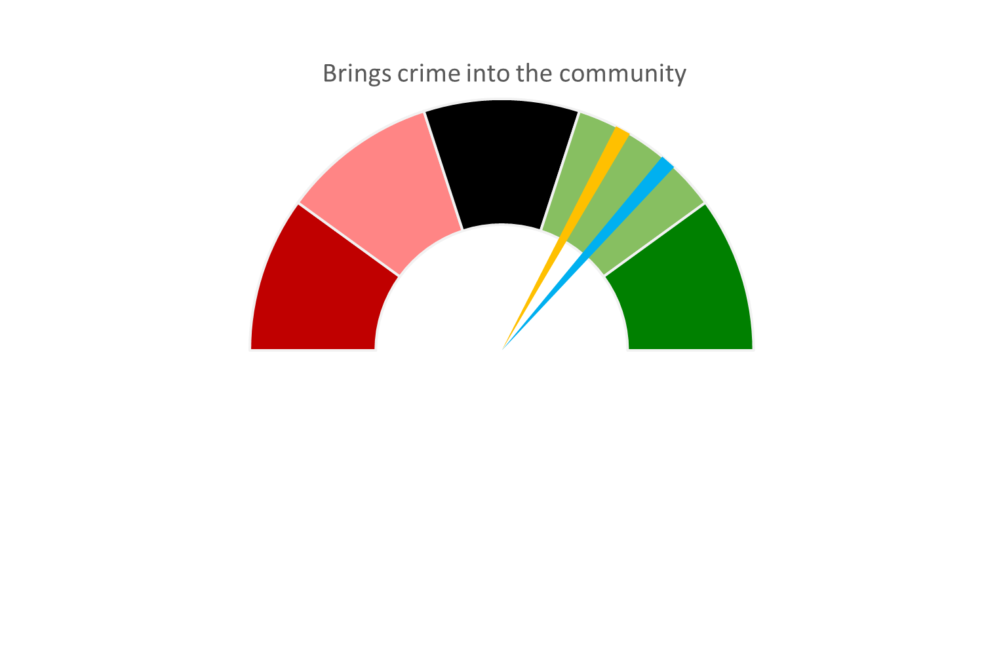
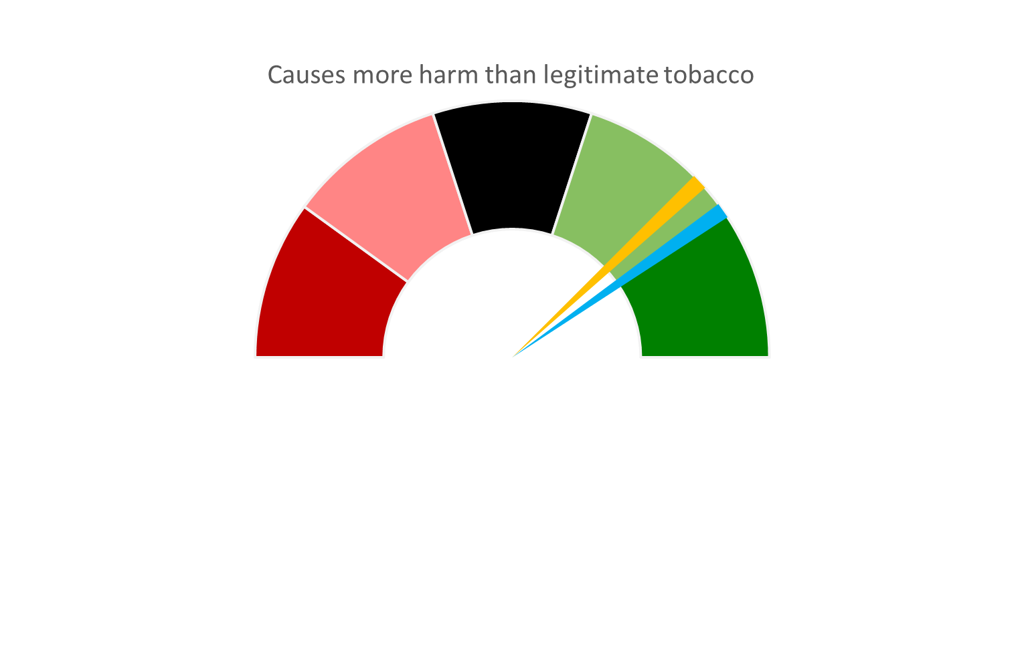
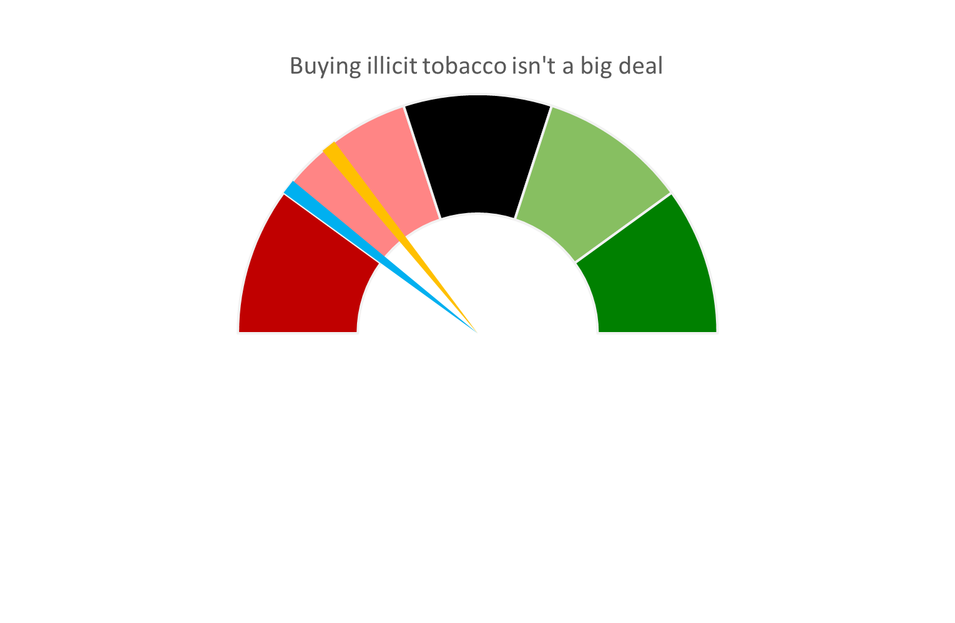
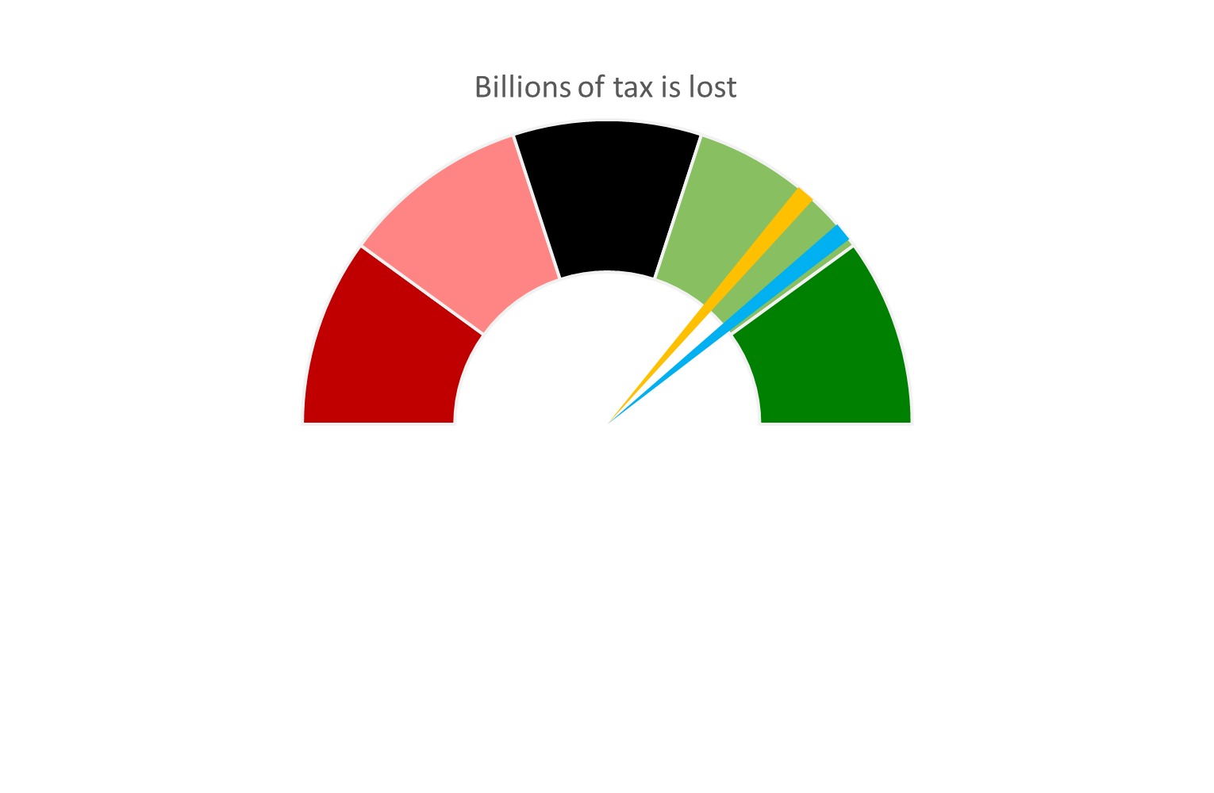
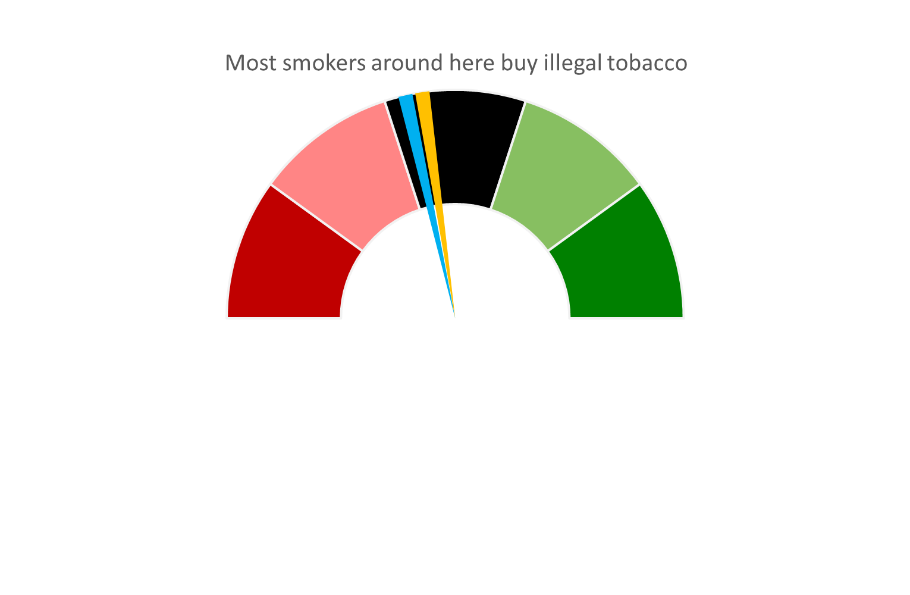
Illicit tobacco attitudes
Smokers
Non-smokers
Disagree strongly
Disagree slightly
Neither
Agree slightly
Agree strongly
Non-smokers have higher agreement levels than smokers, although agreement begins to converge once any impact to children are factored in and the harm it can cause

Slide 16
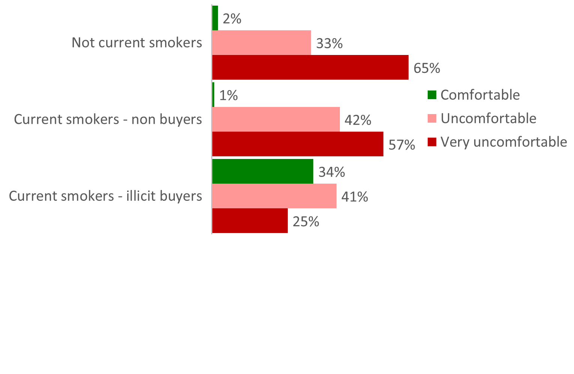
Comfort with illicit tobacco
Four of the key attitude statements are combined to measure an overall comfort score.
This score is then classified into three groups; Comfortable, Uncomfortable and Very uncomfortable.
Comfort classification can give insight into likelihood to report the sale of and purchase of illicit tobacco.

Slide 17
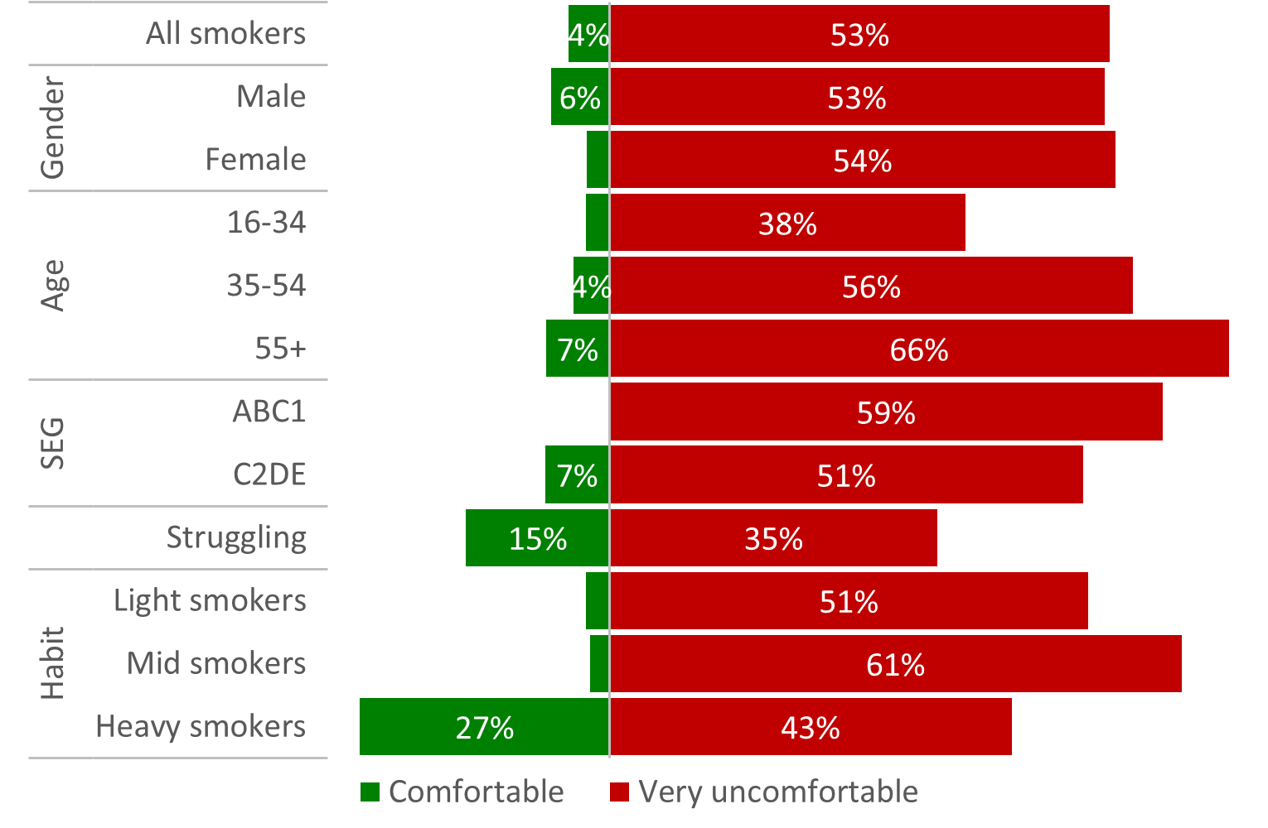
Comfort with illicit tobacco among smokers
Comfort levels among smoker sub-groups
Profile of those smokers more comfortable toward illicit tobacco largely echoes that of illicit buyers

Slide 18
Reporting the sale of illicit tobacco
Likelihood of reporting (general)
Likelihood of reporting by smoker type
Those very uncomfortable
were a fifth more
likely to report
Likelihood of reporting (children)
Any impact on children was seen to increase likelihood of reporting among all sub-groups

Slide 19
Mechanisms and recipients of illicit tobacco reports
Recipients of illicit tobacco reports (those likely to report)
Likely preferred channels of illicit tobacco reports

Slide 20
Addressing the issue of illicit tobacco
Importance placed on tackling illicit tobacco
Support for licencing of tobacco: Non-smokers
Support for licencing of tobacco: Smokers

Slide 21
Inter-relationships of illicit tobacco attitudes & behaviour
Current smoker
Importance of illicit tobacco issue
Shifting comfort will have the widest impact:
Increase likelihood / instances of reporting
Discourage more visible “touting” of goods
Which will decrease offers and likelihood of purchase
Make it less acceptable as a social norm
Comfort with illicit tobacco
Association of illicit tobacco with criminality
Likelihood to report illicit tobacco

Slide 22
York Illicit Tobacco Study 2021: Key Out-takes
1 in 4 smokers have been offered illicit tobacco, the majority of whom go on to try it.
Among those trying illicit tobacco around half go on to become buyers: 11% of smokers are illicit buyers.
For illicit buyers around half of their tobacco consumption is illicit; this equates to an overall market share of 7% for the area.
Over a third of illicit buyers are purchasing suspected counterfeit / fake tobacco.
Males, 16-34 year olds, those struggling financially, hand-rolling tobacco smokers and heavy smokers are most likely to be illicit tobacco buyers.
The COVID-19 pandemic appears to have had some negative impact on the amount of illicit being offered.
Illicit tobacco is typically purchased from a private address or shop; 8 out of 10 just buy from the one trusted source.
Illicit buyers usually pay just under half the RRP for illicit cigarettes / hand-rolling tobacco.
Facilitating the habit was the main draw of illicit tobacco among buyers.
Barriers to illicit purchase centred around poor smoking experience and concerns about their content – as opposed to any moral / illegality concerns.
Comfort with illicit tobacco is a key determinant of likelihood of purchase among smokers.
Any impact the sale of illicit tobacco has on children dramatically increases likelihood of reporting.
Non-smokers are more likely to report the sale of illicit tobacco, unfortunately these are least likely to encounter such sales.
Those likely to report were most likely to contact the Police through a telephone hotline.

Slide 23
Q&A Session

